Slide 1

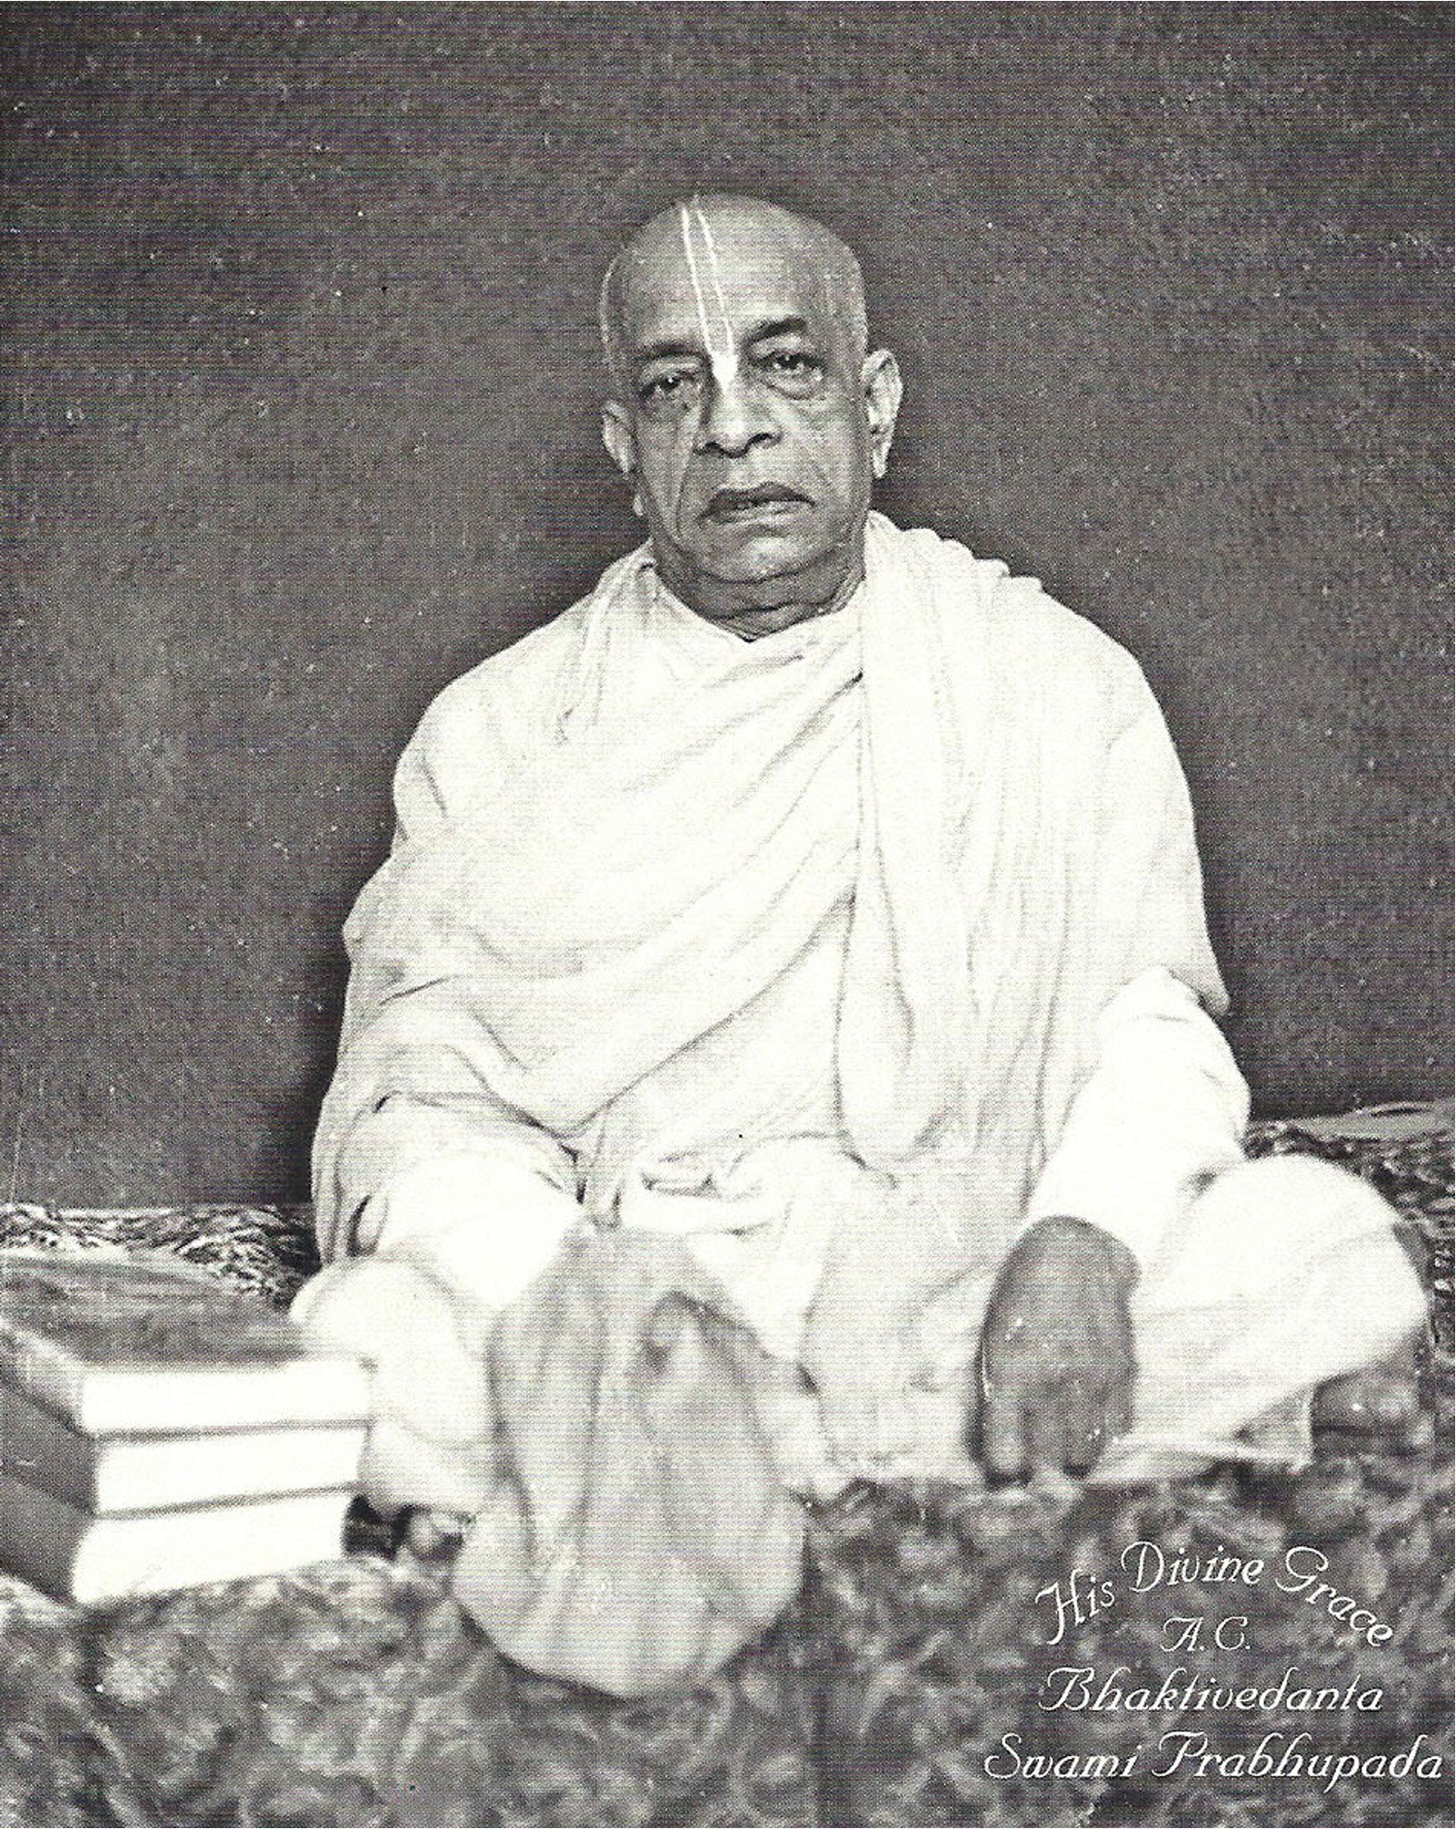
The Rtvik theory
A speculative assault on the timeless Vedic wisdom

Slide 2
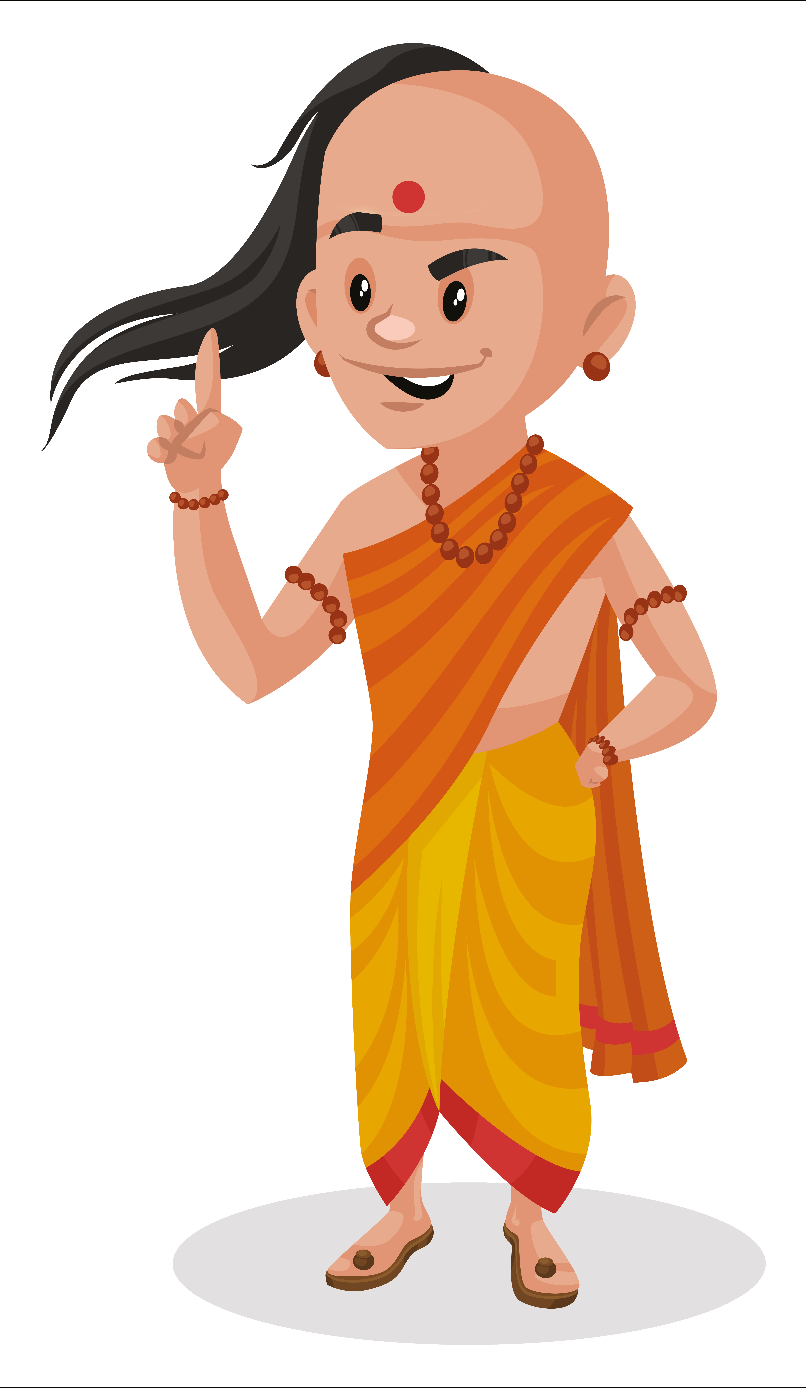
Rtvik heresy
The rtvik theory claims that the disciplic succession should have ended with Srila Prabhupada and that none of Srila Prabhupada's disciples should have become initiating gurus.

Slide 3
Rtvik heresy
Srila Prabhupada should have remained the only initiating guru, continuing to take disciples after his physical departure through the medium of priestly functionaries called rtviks or officiating acharyas.
This is a practice without precedent in Vedic tradition.

Slide 4

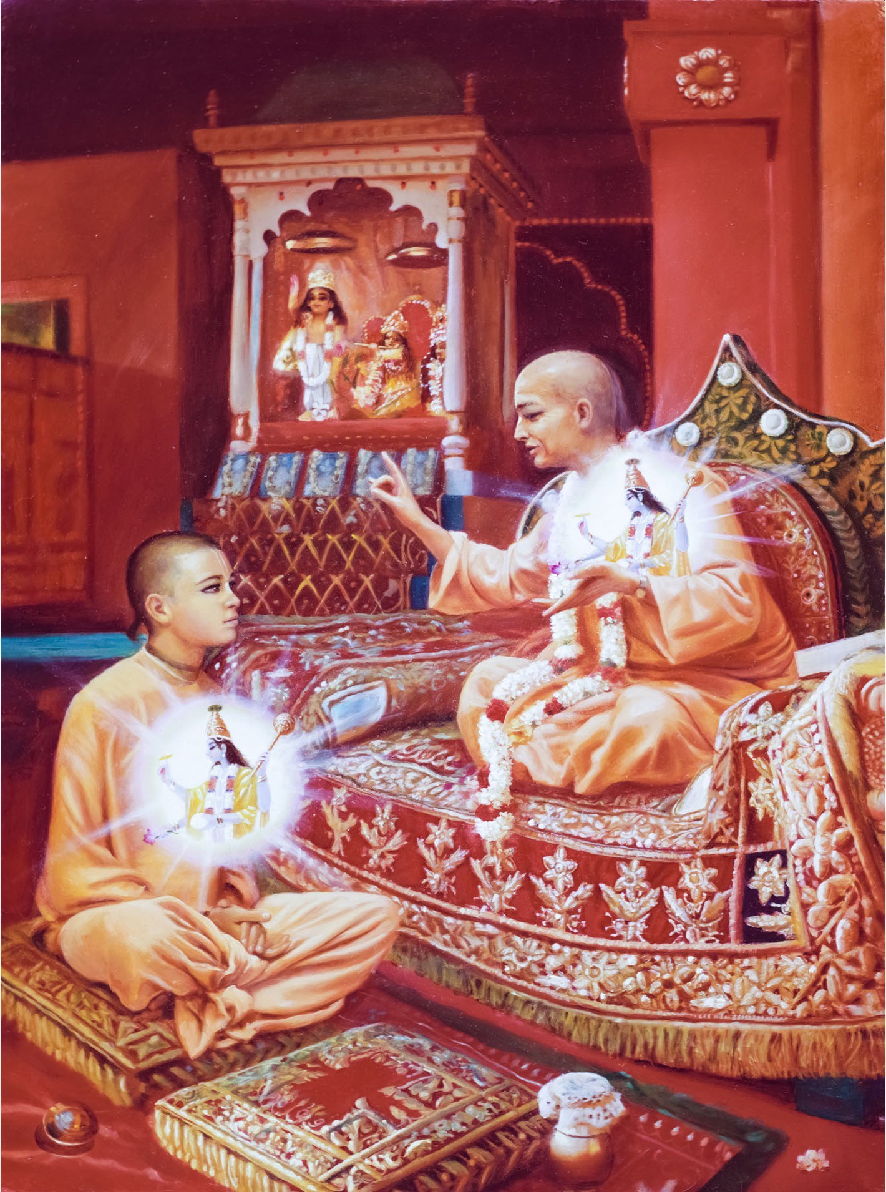
Rather, the Vedic tradition is to accept a physically present
spiritual master.
This is a cornerstone of Vedic principles.
This is one point that the impersonalists, personalists, shaktas etc. all agree on.

Slide 5




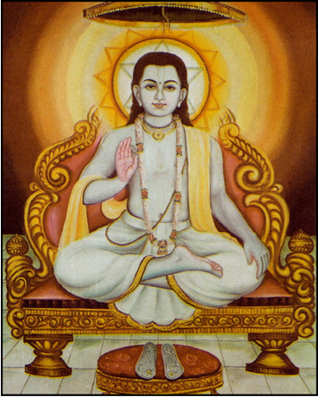
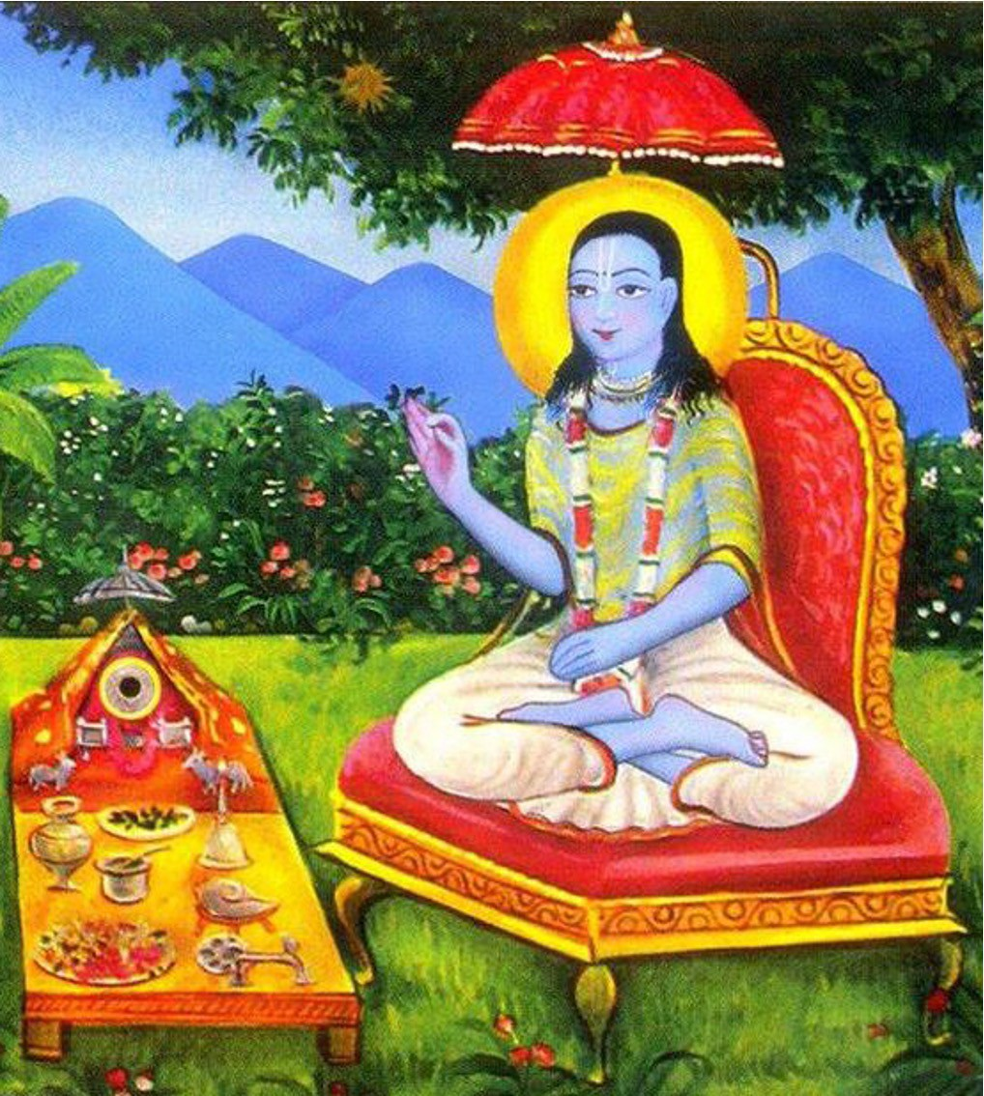
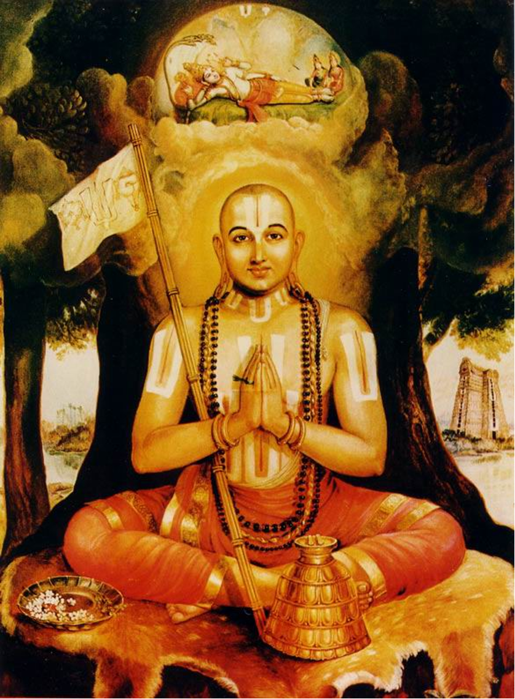
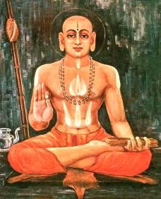
Rudra
Kumara
Lakshmi
Brahma
Sri Vishnusvami
Sri Nimbarka
Sri Ramanuja
Sri Madhva
All four Vaisnava sampradayas teach and practice the tradition of accepting initiation in
an ongoing disciplic line.

Slide 6

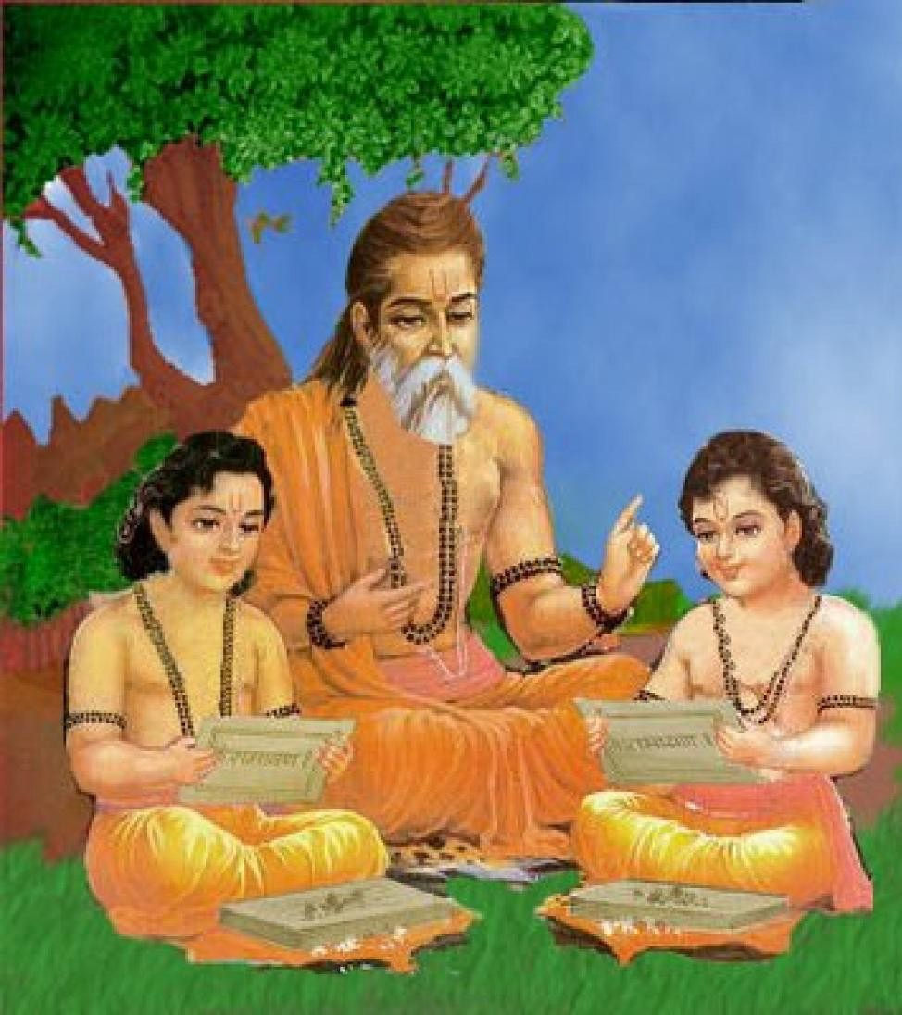
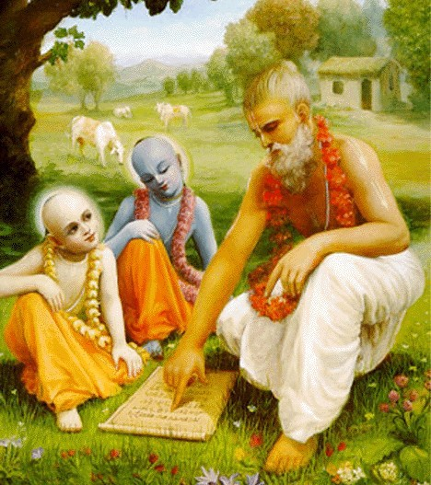
Even the Supreme Lord took initiation just to set the example.
Rama & Laksman took initiation from Vasistha Muni.
Krishna & Balaram took initiation from Sandipani Muni.

Slide 7

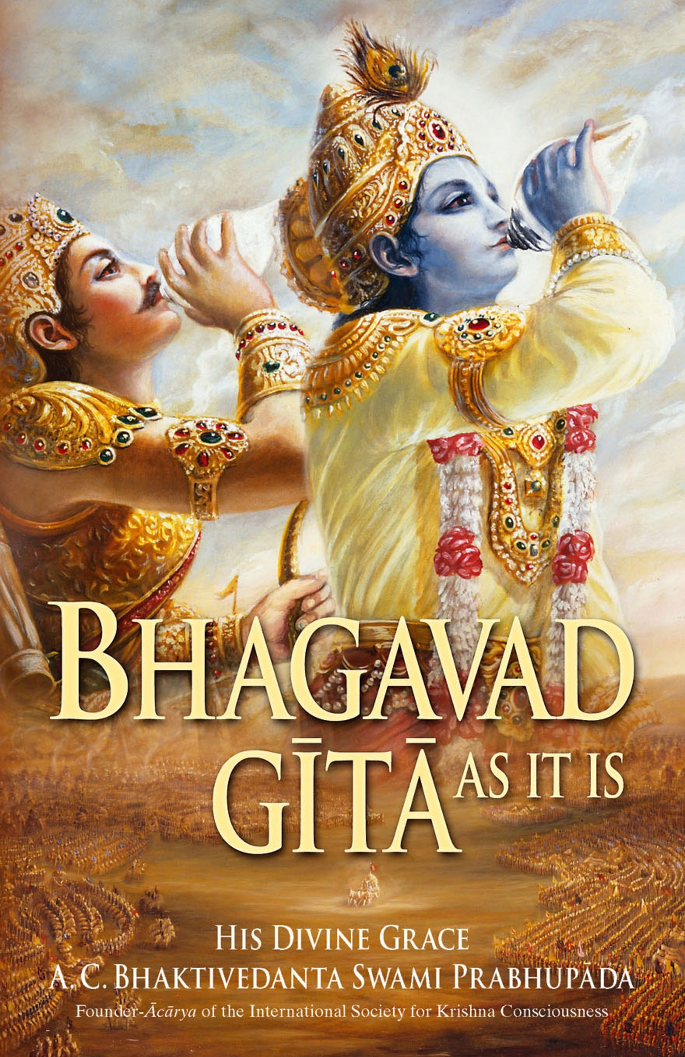
Just try to learn the truth by approaching a spiritual master.
Inquire from him submissively and render service unto him.
The self-realized souls can impart knowledge unto you because they have seen the truth.
BG 4.34

Slide 8

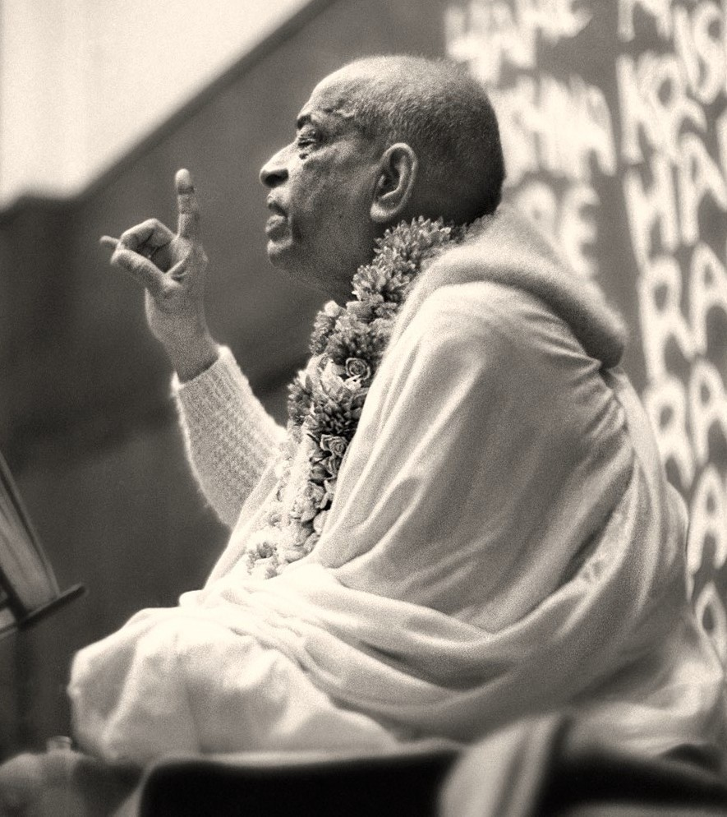
Srila Prabhupada:
One who is now the disciple is the next spiritual master.
Srimad Bhagavatam
2.9.43 - Purport

Slide 9

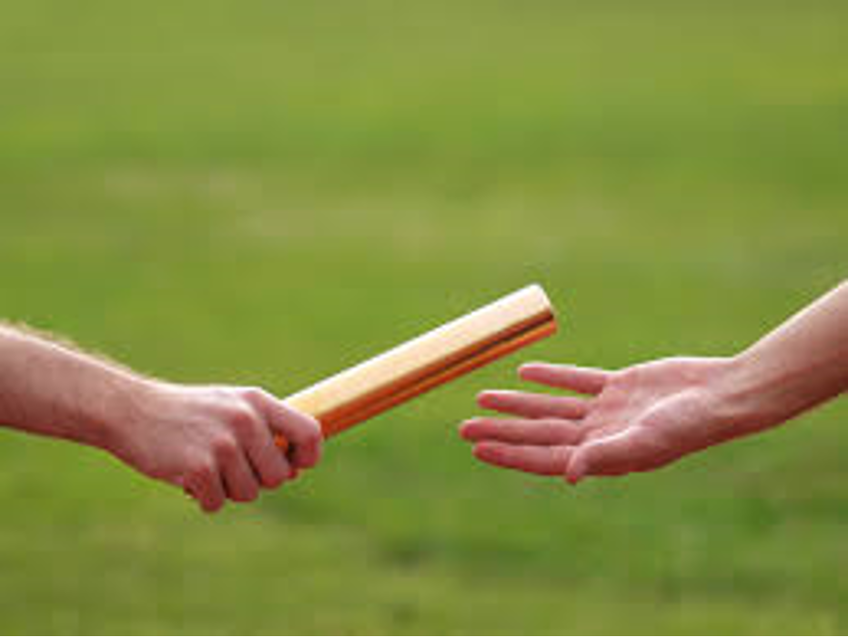
During his lifetime, Srila Prabhupada prepared his disciples to take the role of guru after his departure.
Mohsin Hassan: After you, is there any decision
been made who will take over?
Room conversation July 18th, 1971

Slide 10
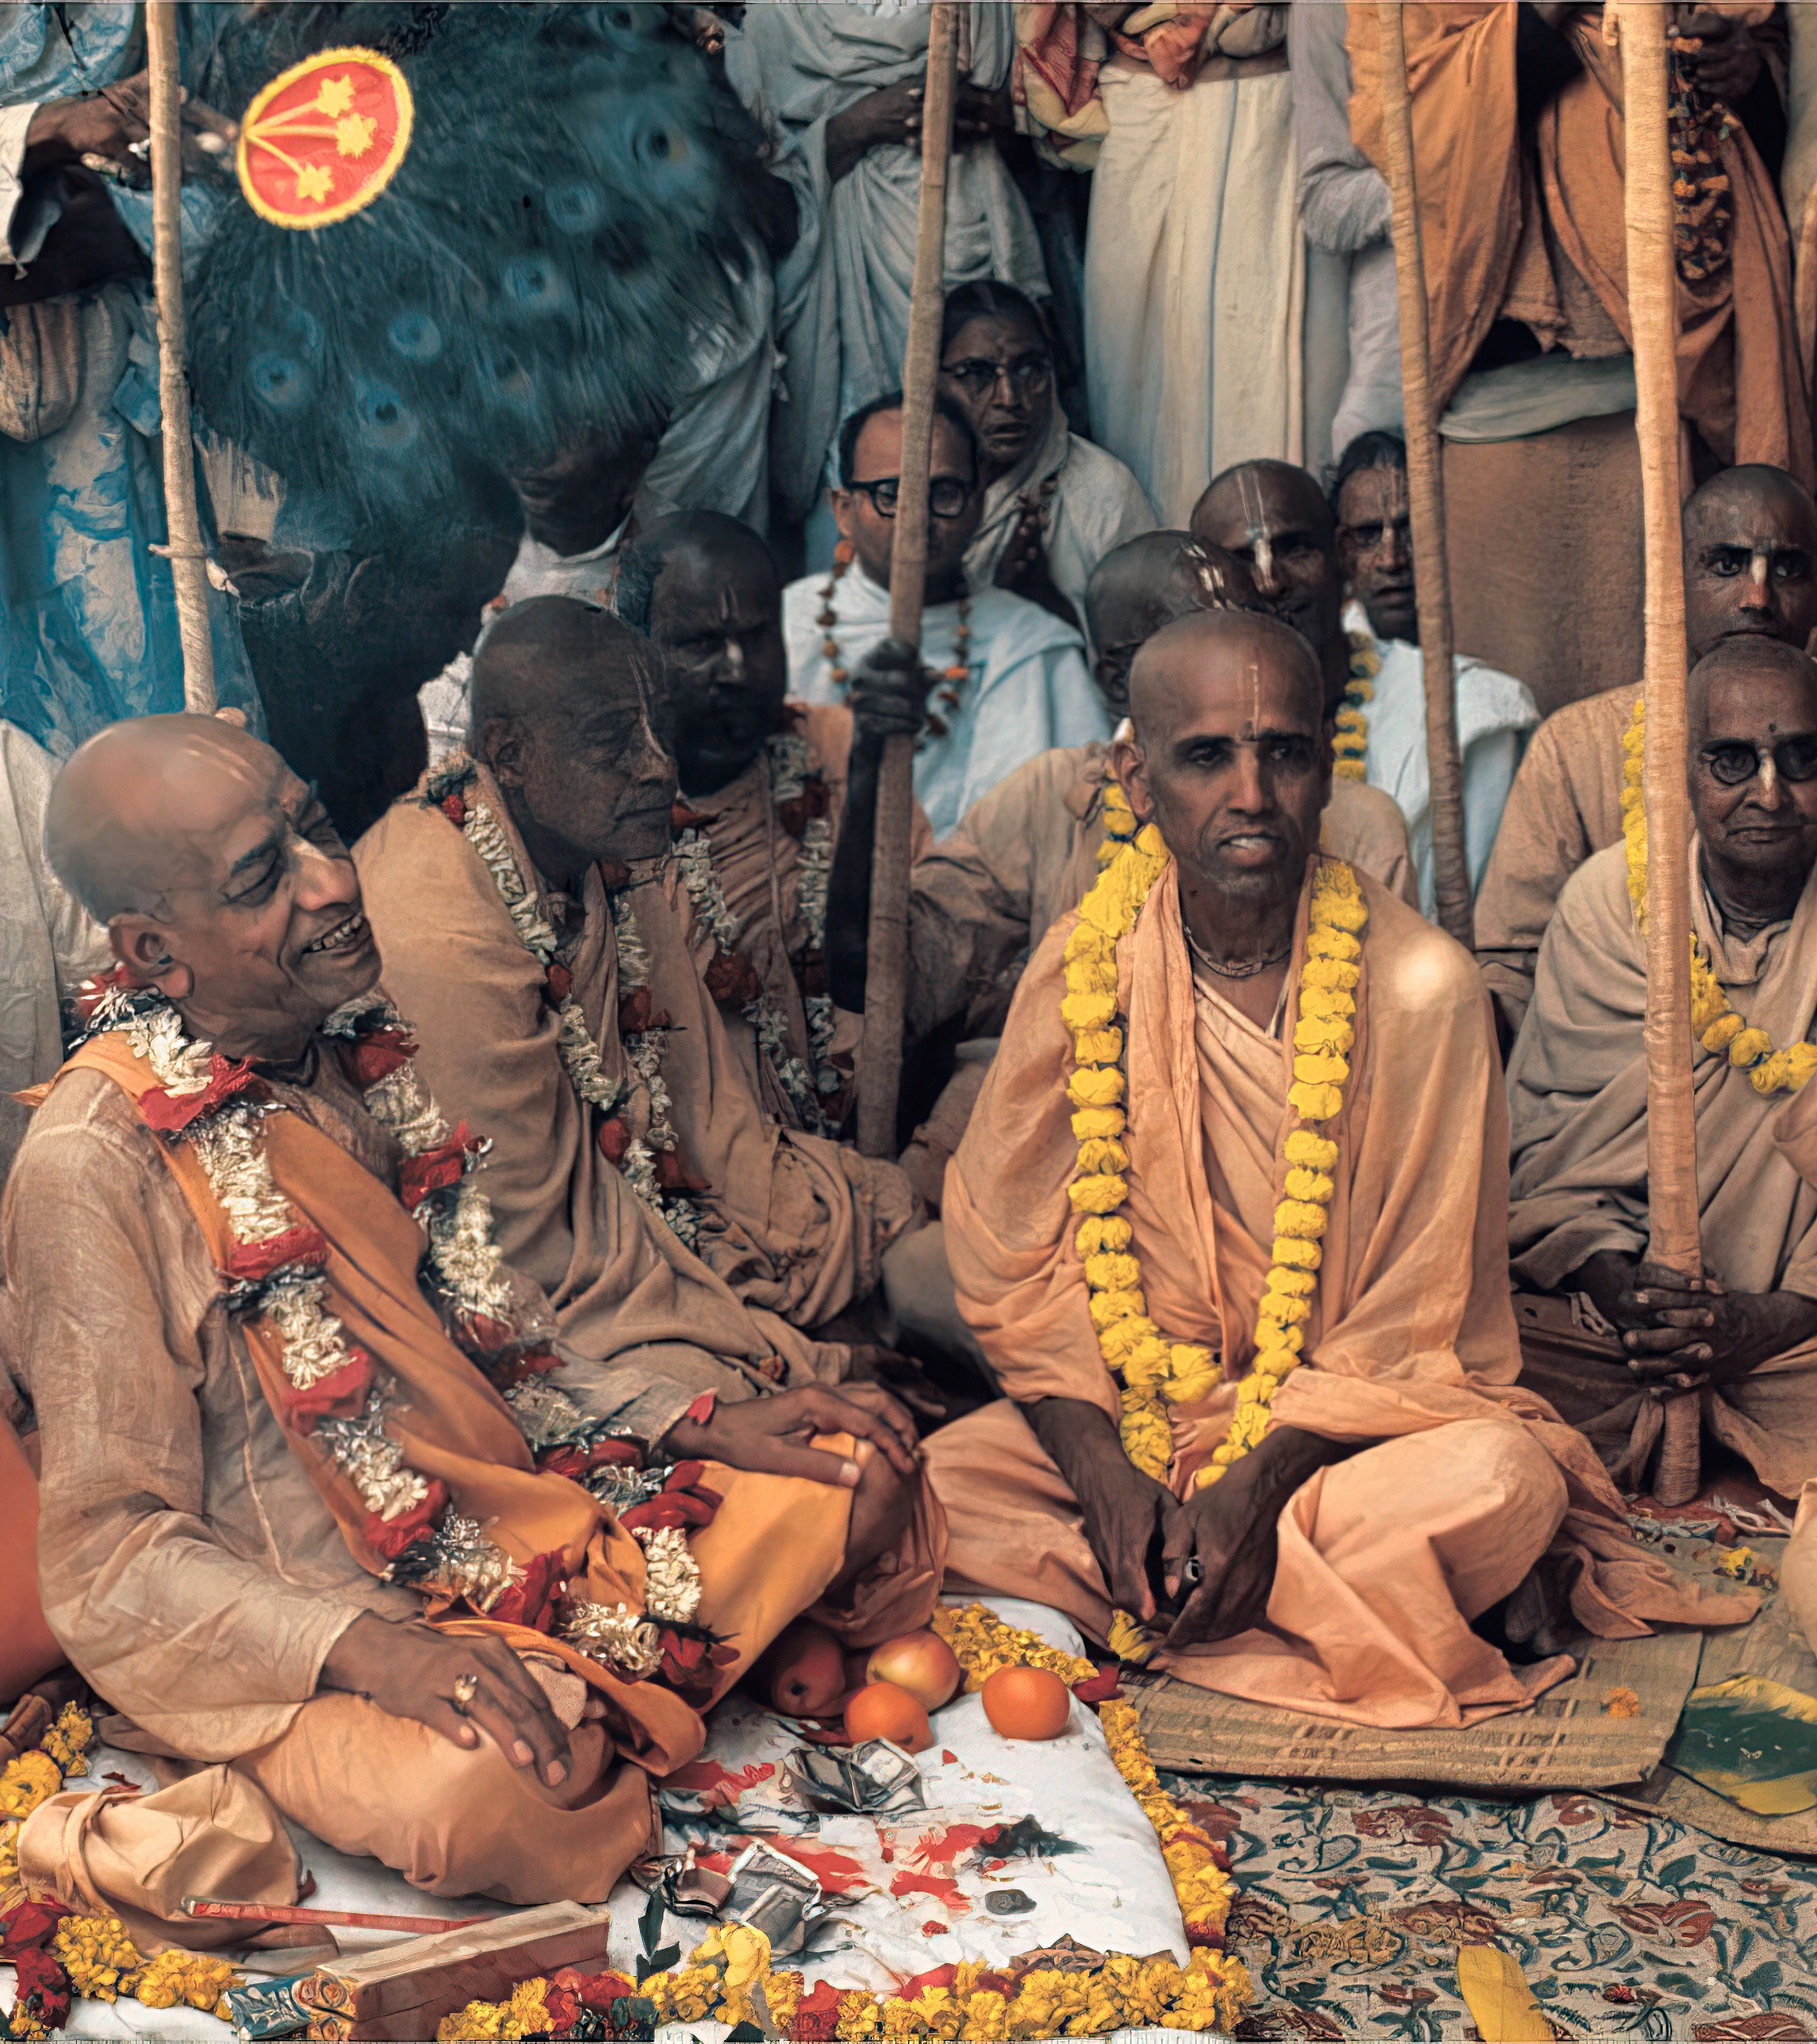
Srila Prabhupada’s reply:
Yes. All of them will take over. These students, who are initiated from me, all of them will act as I am doing. Just like I have got many Godbrothers, they are all acting. Similarly, all these disciples which I am making, initiating, they are being trained to become future spiritual masters. . . .
Whoever is initiated, he is competent to make disciples. But as a matter of etiquette they do not do so in the presence of their spiritual master. This is the etiquette. Otherwise, they are competent. They can make disciples and spread.

Slide 11
We are interested in preparing acharya [guru], but the etiquette is, at least for the period the guru is present, one should not become acharya. Even if he is complete he should not, because the etiquette is, if somebody comes for becoming initiated, it is the duty of such person to bring that prospective candidate to his acharya…
Lecture April 6th, 1975

Slide 12
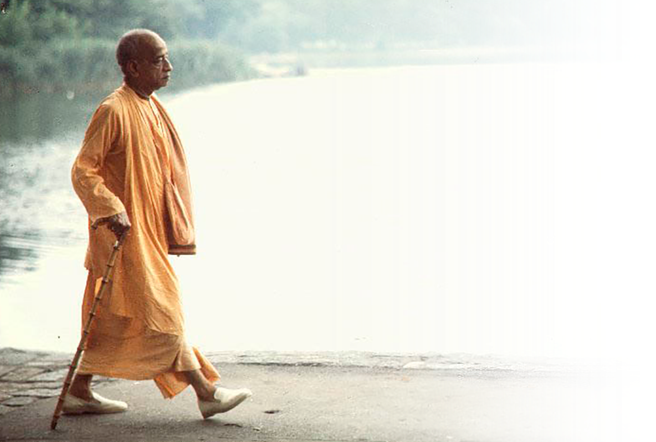
And to become acharya is not very difficult. First of all, to become very faithful servant of your acharya, follow strictly what he says. Try to please him and spread Krsna consciousness. That's all. It is not at all difficult…
April 6, 1975, Srila Prabhupada's public lecture in Mayapur

Slide 13
Every student is expected to become Acharya. Acharya means one who knows the scriptural injunctions and follows them practically in life, and teaches them to his disciples. . . . Keep trained up very rigidly and then you are bonafide Guru, and you can accept disciples on the same principle... I want to see my disciples become bonafide Spiritual Master and spread Krsna consciousness very widely, that will make me and Krsna very happy.
Letter to Tusta Krishna / December 2nd, 1975

Slide 14

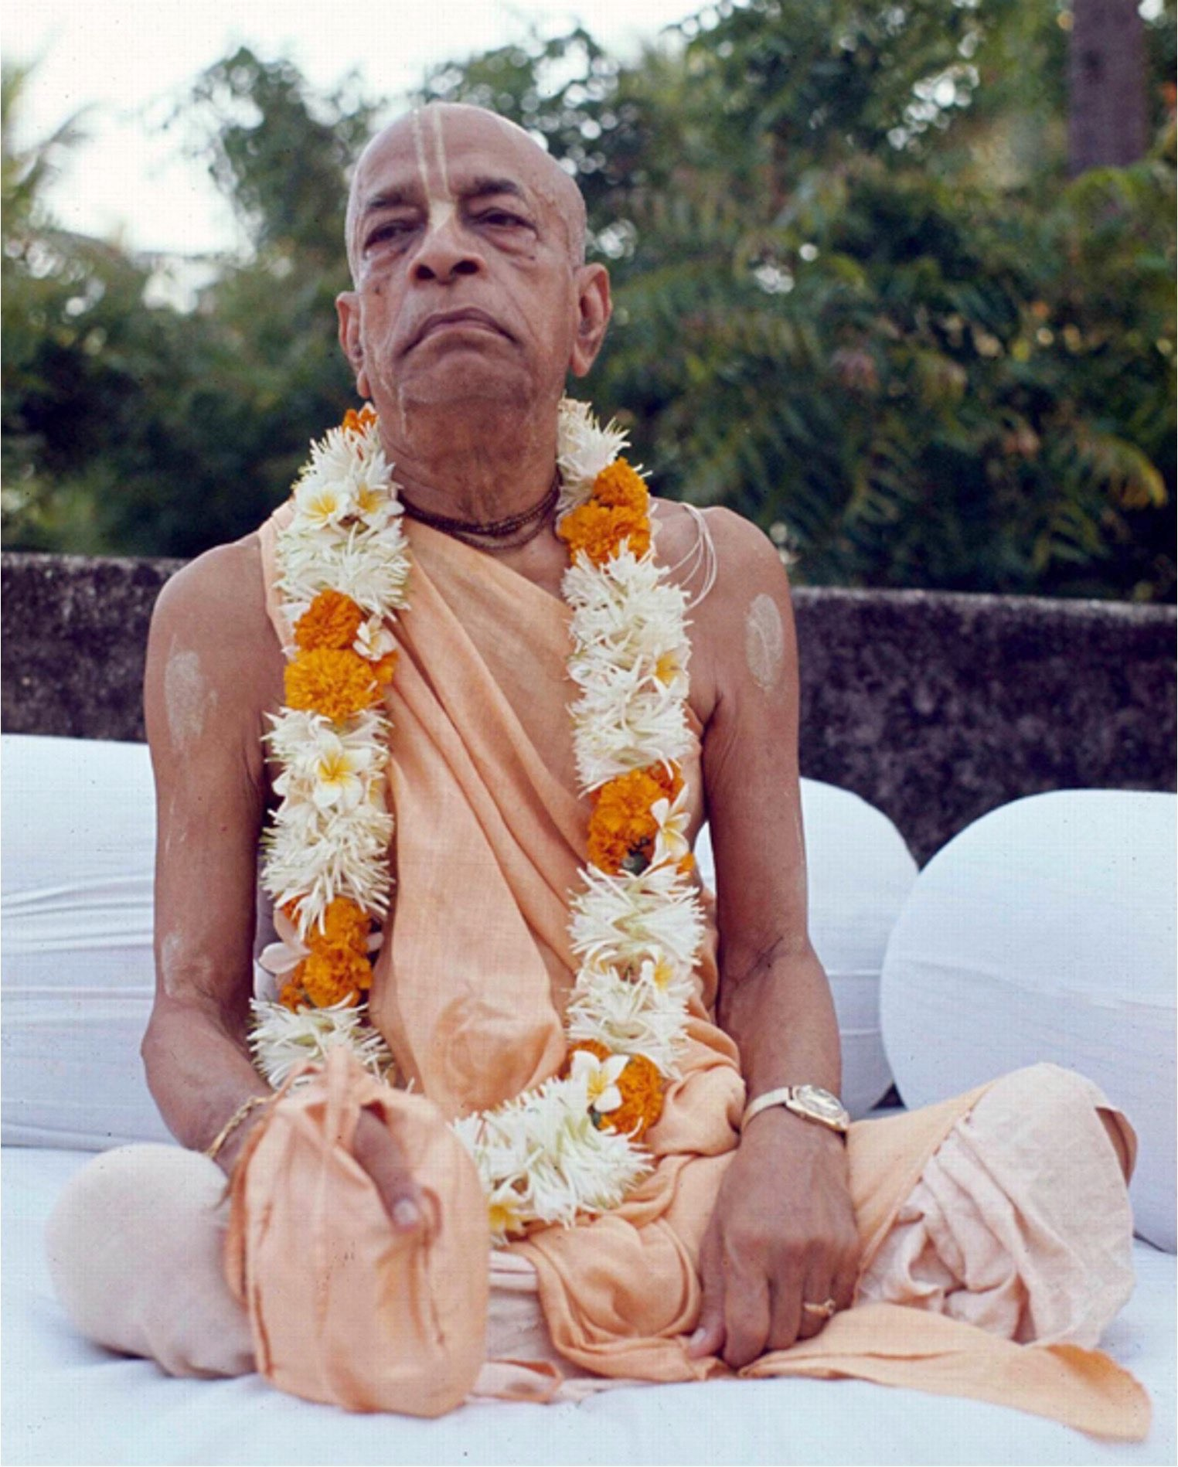
Srila Prabhupada was completely consistent in his statements about his vision for the continuation of the disciplic succession after his departure.

Slide 15

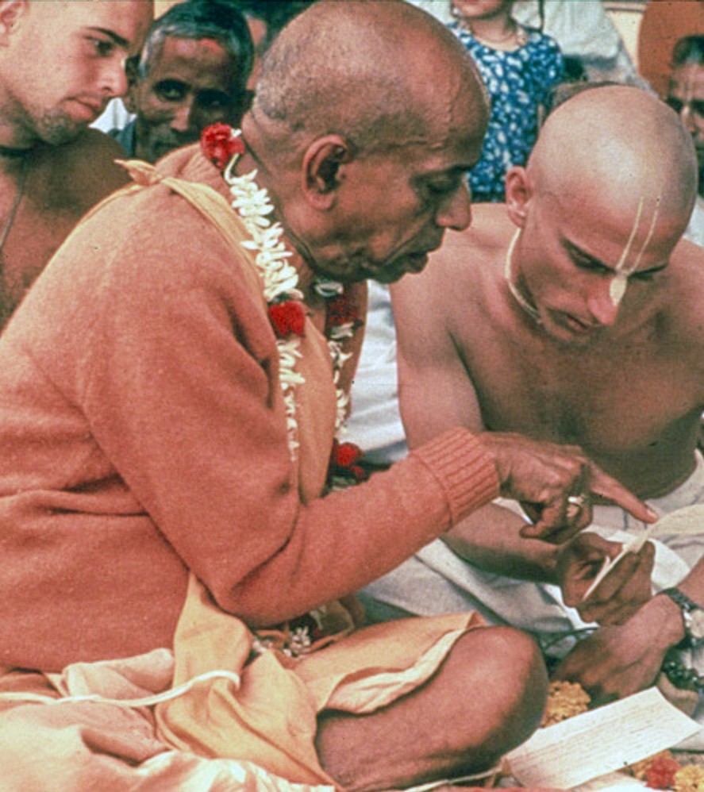
Vedic tradition
Following these instructions, and the example shown in Vedic culture since time immemorial, some of Srila Prabhupada's disciples, after his departure, have become gurus and accepted disciples of their own.

Slide 16

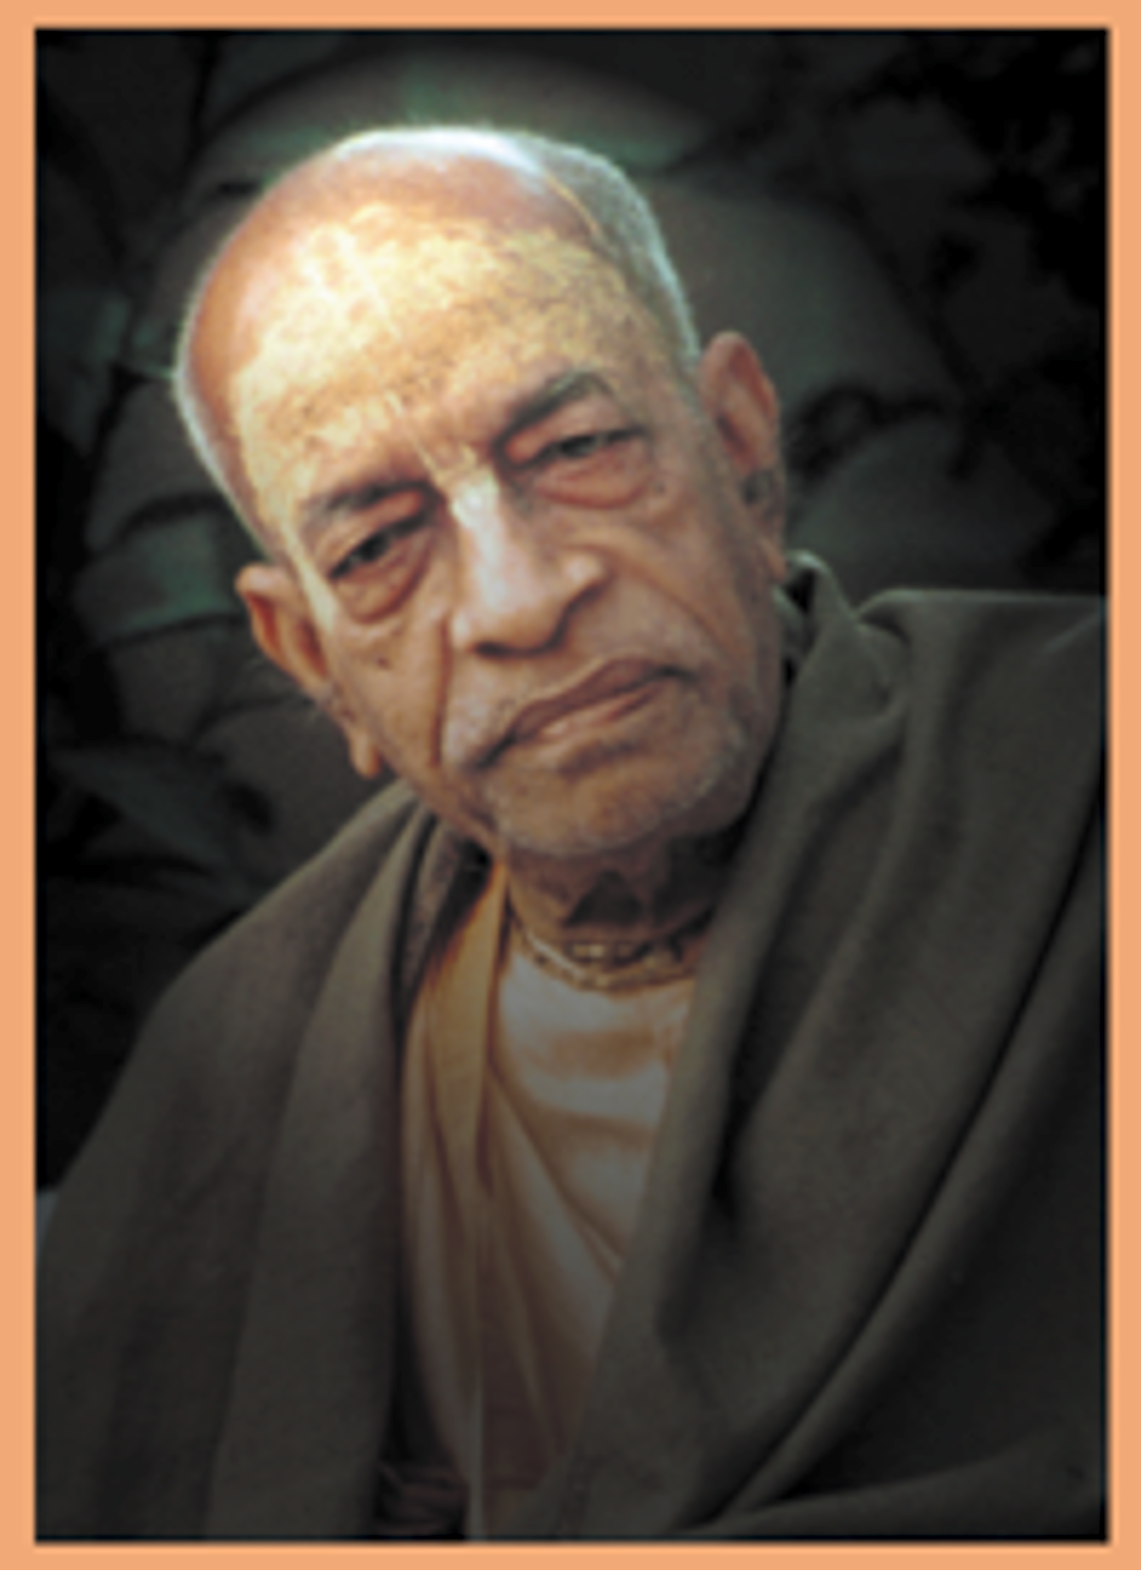
Not all of these gurus have lived up to their responsibilities and this has naturally caused disturbances.
But because rtvikism violates both the Vedic principle of disciplic succession and Srila Prabhupada's direct instruction that his disciples become regular gurus, ISKCON has rejected it.

Slide 17
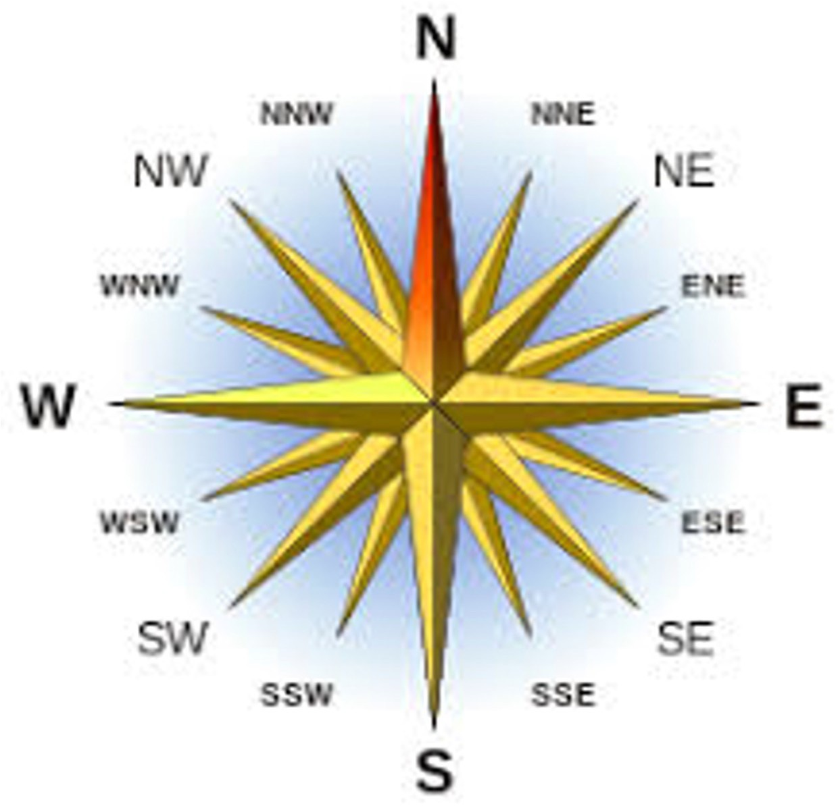
Rather than whimsically changing the instructions of Srila Prabhupada, as the advocates of the rtvik theory have done,
ISKCON prefers to address these problems by making better efforts to follow his instructions and to come to the standard he gave us.

Slide 18
Rtvik heresy
Advocates of the rtvik theory seek to justify their cause solely through a distorted and false interpretation of a single letter written by
Srila Prabhupada's secretary on July 9, 1977.

Slide 19

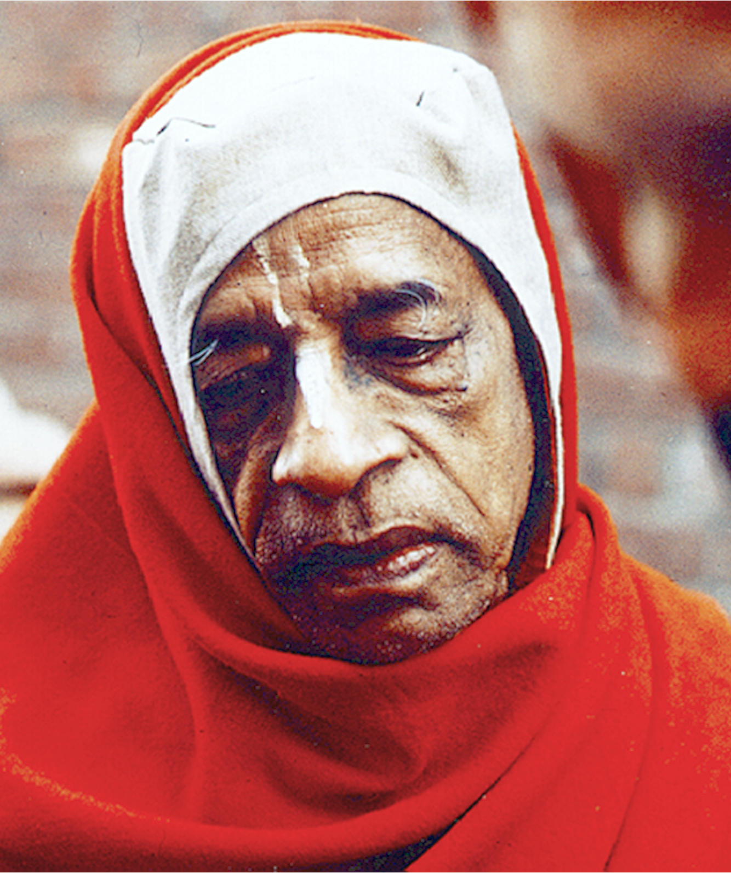
The July 9th letter does not mention Srila Prabhupada's departure
nor does it refer to how he intended initiations to go on after
his physical departure.

Slide 20
Srila Prabhupada directed that a number of his senior disciples should answer the letters and conduct initiation ceremonies on his behalf, with the new initiates becoming Srila Prabhupada's disciples.
So Yes, Srila Prabhupada established a rtvik or proxy system in the latter part of 1977. It was for the few months he remained physically present and because the etiquette is that
one does not initiate while one’s own diksha guru is still present.

Slide 21
The history
Srila Prabhupada asked the GBC members in Vrindaban to come to him with questions on any major points they wanted clarification and confirmation on. The conversation, the questions and Srila Prabhupada’s answers, were recorded on May 28th, 1977.
One of those questions the GBC asked of Srila Prabhupada was:
Then our next question concerns initiations in the future, particularly at that time when you're no longer with us. We want to know how first and second initiation would be conducted.

Slide 22
Srila Prabhupada’s answer:
Srila Prabhupada starts by explain the system to be practiced while he is still physically present:
Satsvarupa: Then what is the relationship of that person who gives the initiation and the…
Srila Prabhupada: He's guru. He's guru.
Satsvarupa: But he does it on your behalf.
Srila Prabhupada: Yes. That is formality. Because in my presence one should not become guru, so on my behalf, on my order… Amara ajnaya guru hana. Be actually guru, but by my order…

Slide 23
After explaining how initiations would go on while he was still physically present, Srila Prabhupada then states how initiations should go on when he was no longer physically present.
Tamal Krsna: ... The people who they give diksha to, whose disciple are they?
Srila Prabhupada: They're his disciple.
Tamal Krsna: They're his disciple?
Srila Prabhupada: Who is initiating. He is grand-disciple.
Srila Prabhupada: When I order, 'You become guru,' he becomes regular guru. That's all. He becomes disciple of my disciple. That's it.

Slide 24

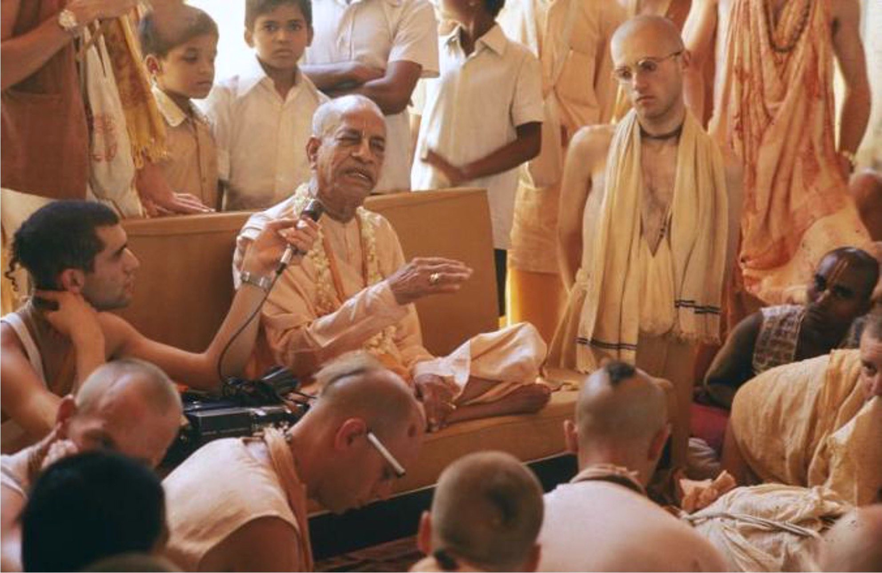
Srila Prabhupada maintained the Vedic tradition
His disciples should become regular gurus,
with disciples of their own, but only after his departure
and only if they were qualified.

Slide 25

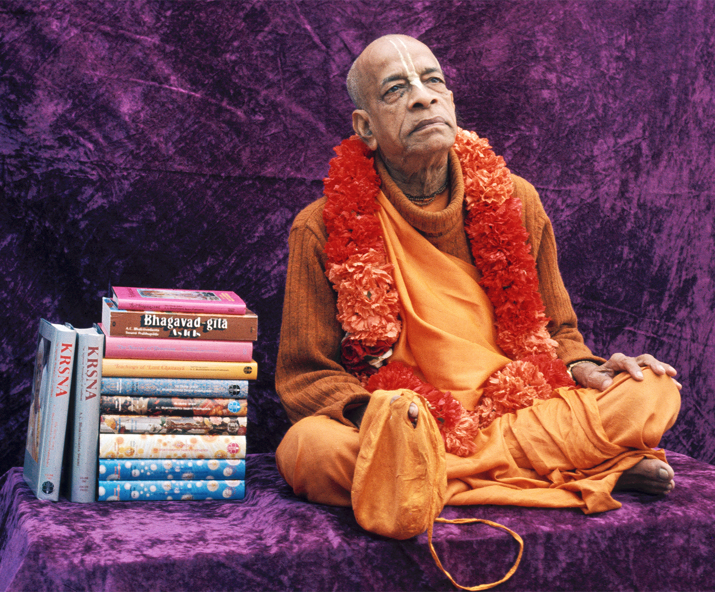
If Srila Prabhupada were proposing such a drastic break from Vedic tradition, after so carefully presenting all of other aspects of philosophy and practice, one would expect to find many statements by him on this topic.
Yet the advocates of the rtvik theory have never produced even a single statement by Srila Prabhupada in which he
says that he would continue to initiate
disciples after his physical departure.

Slide 26
Rtvik heresy
Advocates of the rtvik theory think they are glorifying Srila Prabhupada but what they are actually saying is:
Srila Prabhupad was so spiritually powerful and potent, yet he could not produce one single disciple qualified to become a regular guru and accept disciples.

Slide 27
Rtvik heresy
Followers of the rtvik theory may believe that Srila Prabhupada accepts them as initiated disciples, but where is the tangible confirmation of this?
Rather, this view is only their wishful thinking.

Slide 28

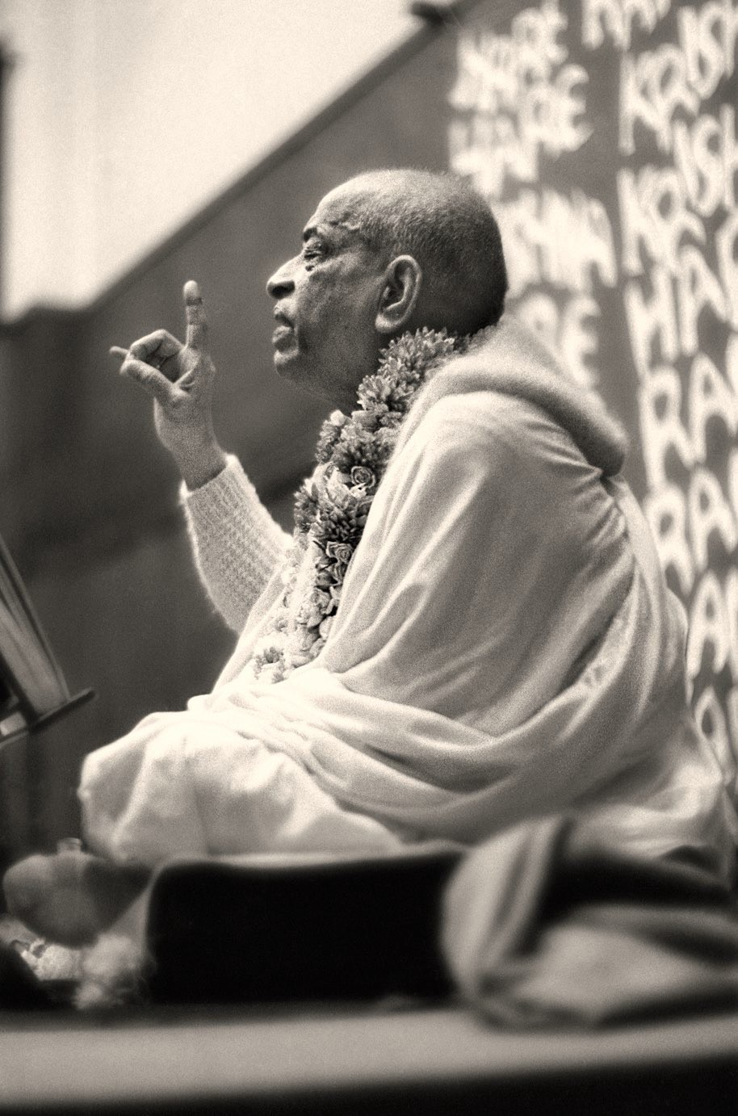
In 1990 the GBC officially rejected the rtvik philosophy, concluding that it violates the Vedic system and Srila Prabhupada's direct instructions.

Slide 29
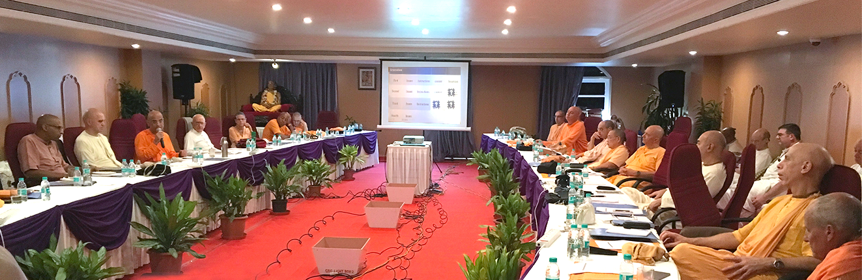
GBC Resolution:
The doctrine that Srila Prabhupada continues to initiate direct diksha disciples after his departure from this world through officiating priests (rtviks) is a dangerous philosophical deviation. It is totally prohibited in ISKCON. No devotee shall participate in such posthumous rtvik initiation ceremonies in any capacity, including acting as rtvik, initiate, assistant, organizer, or financier.
No ISKCON devotee shall advocate or support its practice.

Slide 30

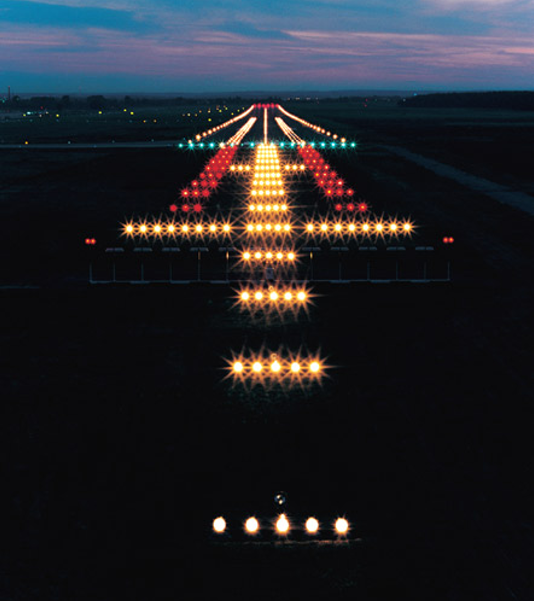
Change the practice and the lineage is lost.
Lose the lineage and we are lost.
We would be flying blind.

Slide 31

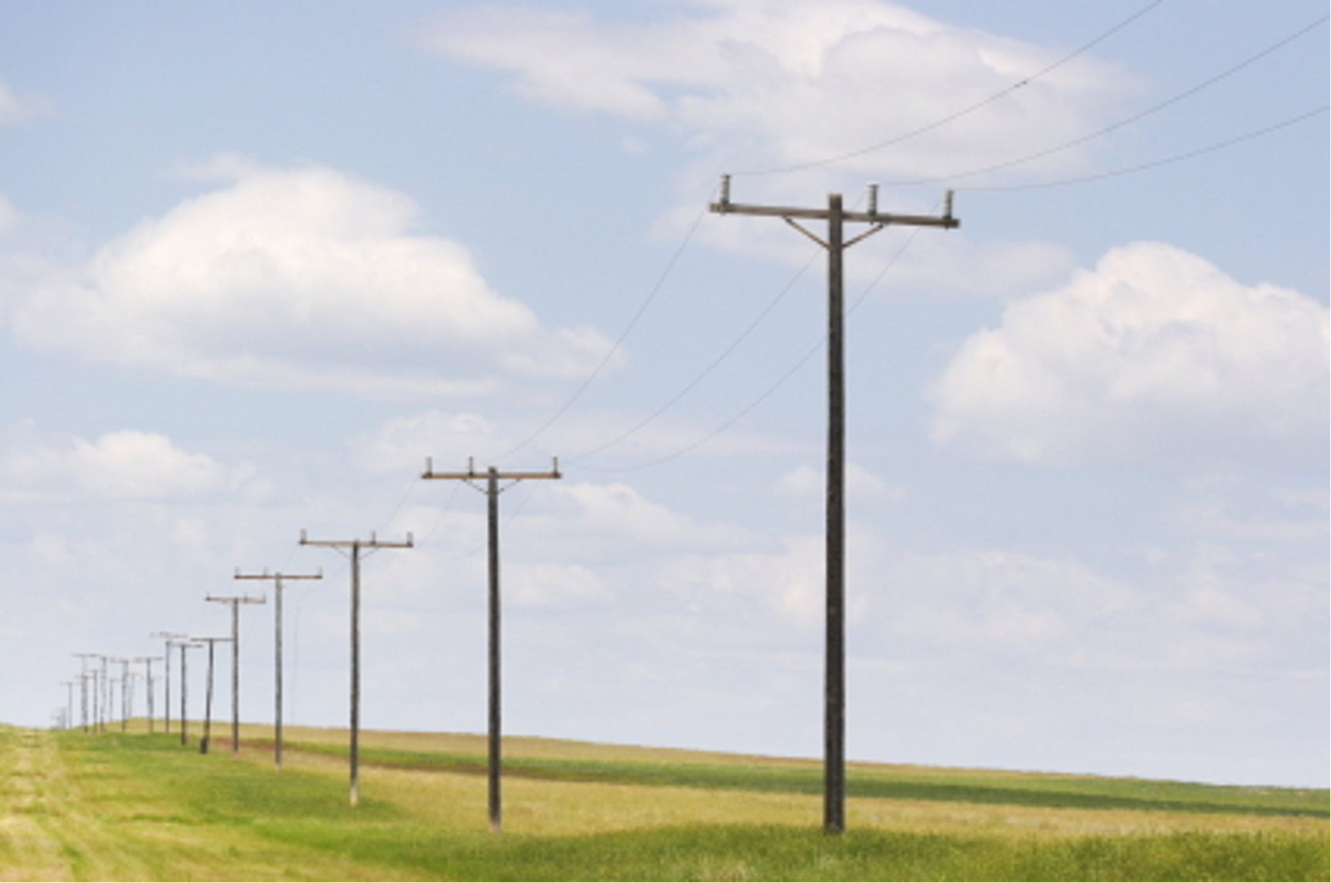
Amongst gurus in a sampradaya, the founder-acharya holds a special position.
He is the siksha guru for all
the following members of his line.

Slide 32
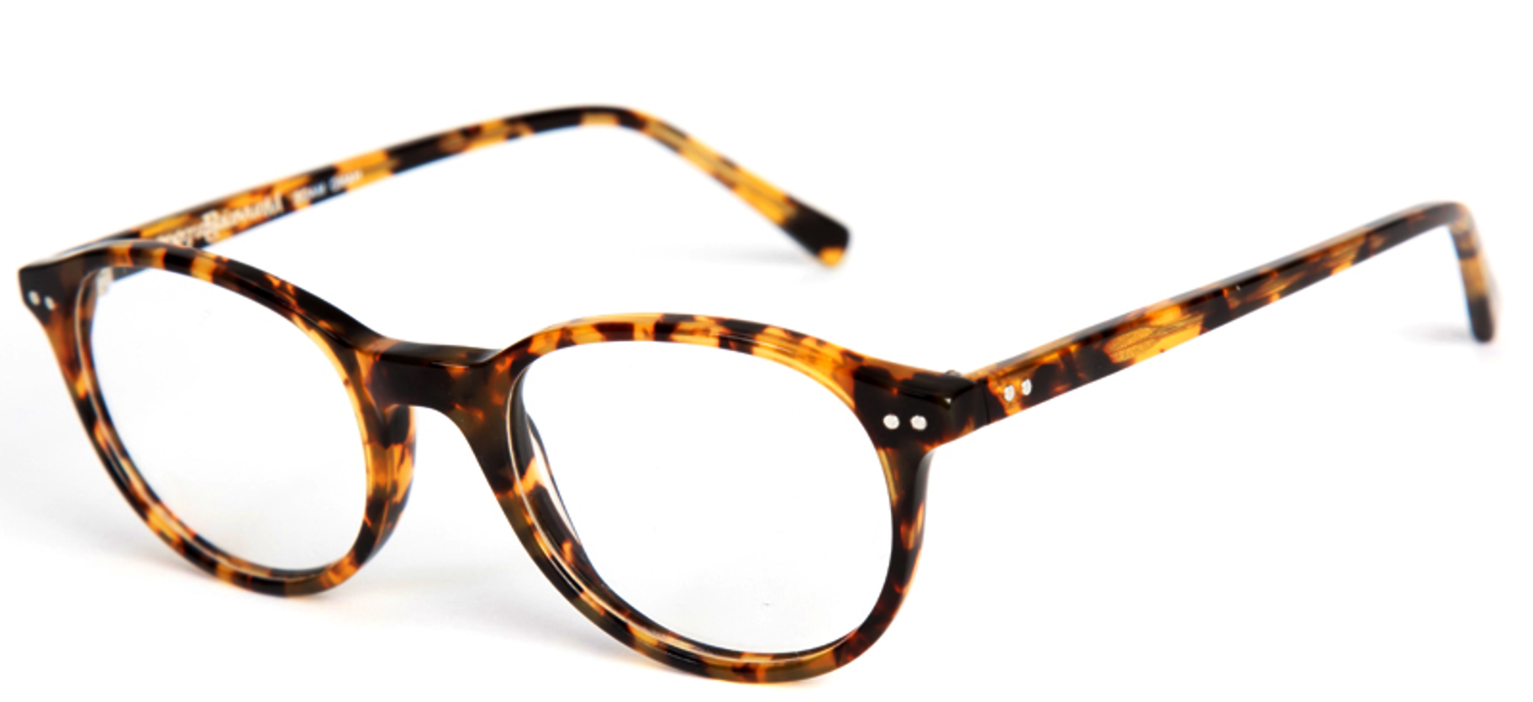
The mystery of the sampradaya
BG 18.75 / purport
The experience is direct via the spiritual master.
As glasses serve as a medium to bring an object into focus.

Slide 33

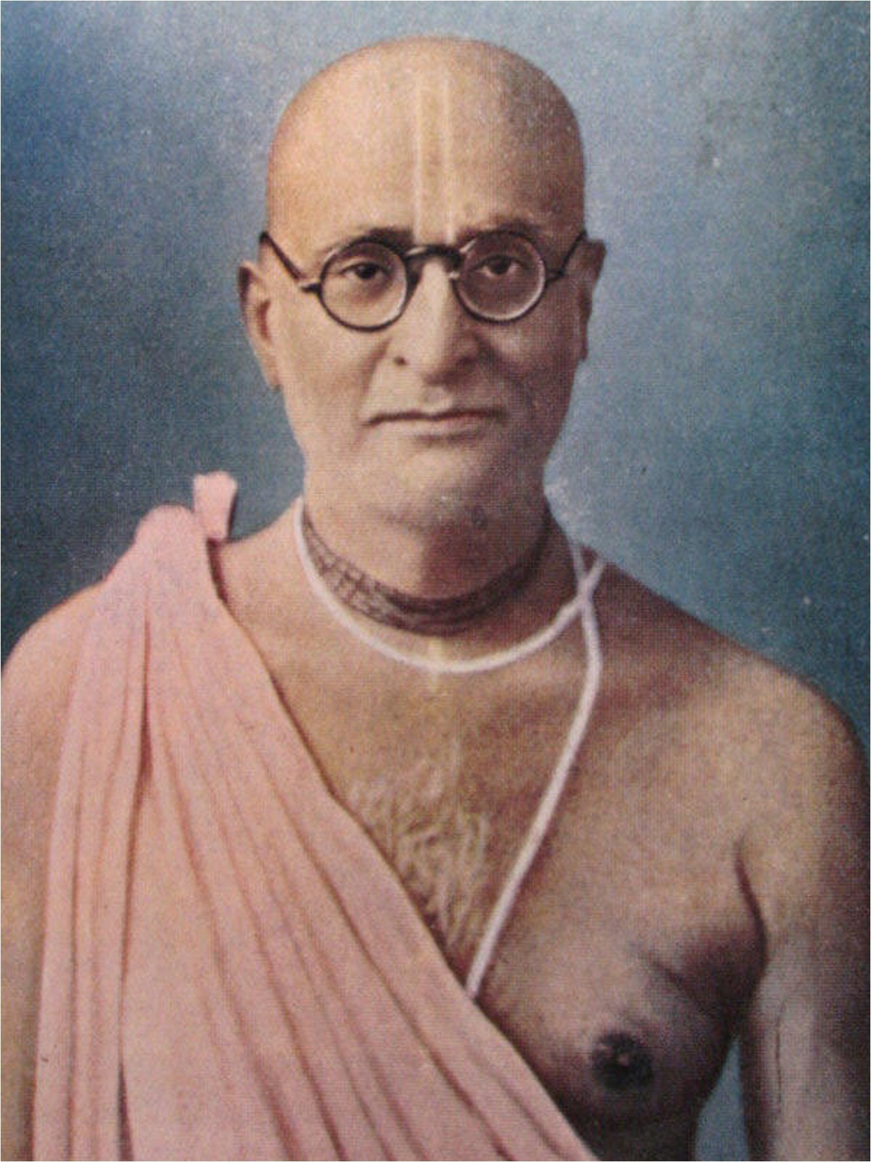
You should always pray to His Divine Grace because naturally he will be more affectionate to you than to me.
Generally one is more affectionate to the grandchildren than to the children directly.
So I am sure that my Guru Maharaj will be easily inclined to your prayers than that of mine. You will do good always by offering your prayers to His Divine Grace Bhaktisiddhanta Goswami Maharaj.
Letter to Brahmananda December 12th,1968

Slide 34

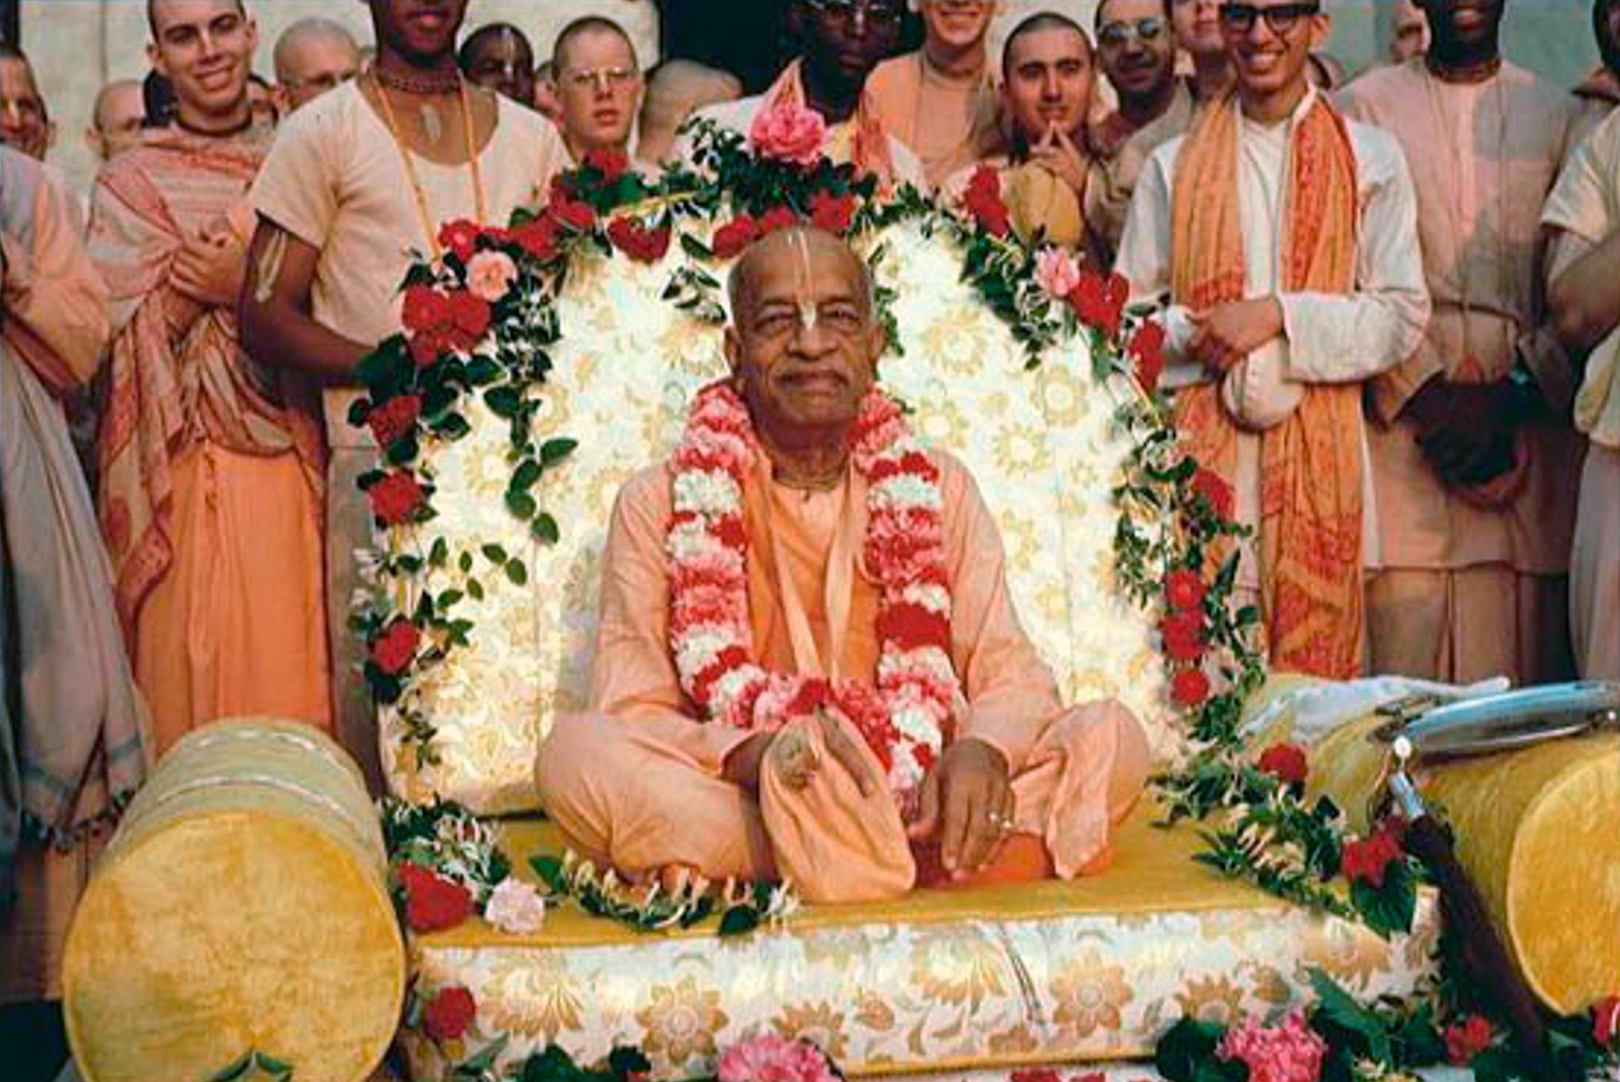
My dear boys and girls, you are working so hard for broadcasting the glories of Lord Krishna’s lotus feet, and thus my Guru Maharaja will be so pleased
upon you.
Surely my Guru Maharaja will bestow his blessing a thousand times more than me.
Letter to Ramesvara 4/15/1973

Slide 35

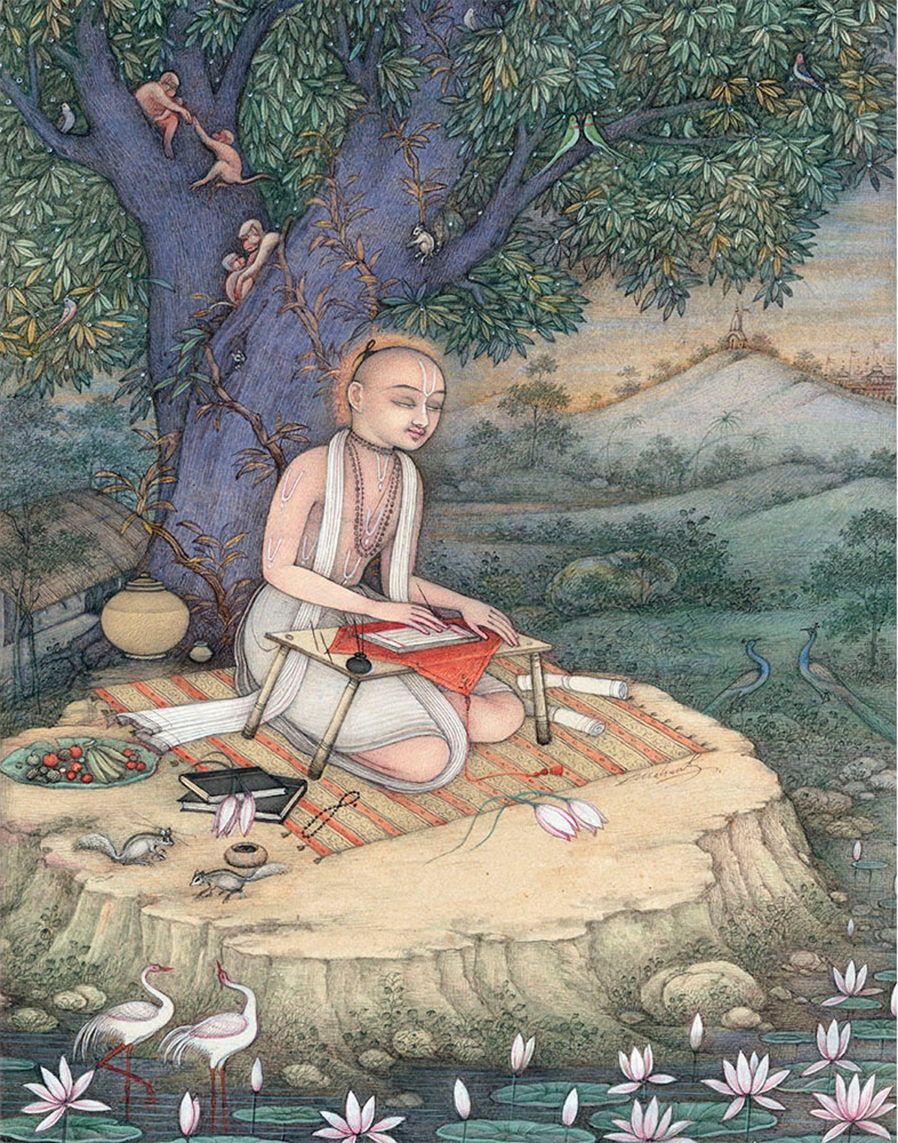
Krsnadasa Kaviraja, who presented the deepest understanding of Lord Chaitanya and His teaching, was a grand disciple of Lord Chaitanya.
He understood through his diksha guru, Raghunath dasa Goswami.

Slide 36

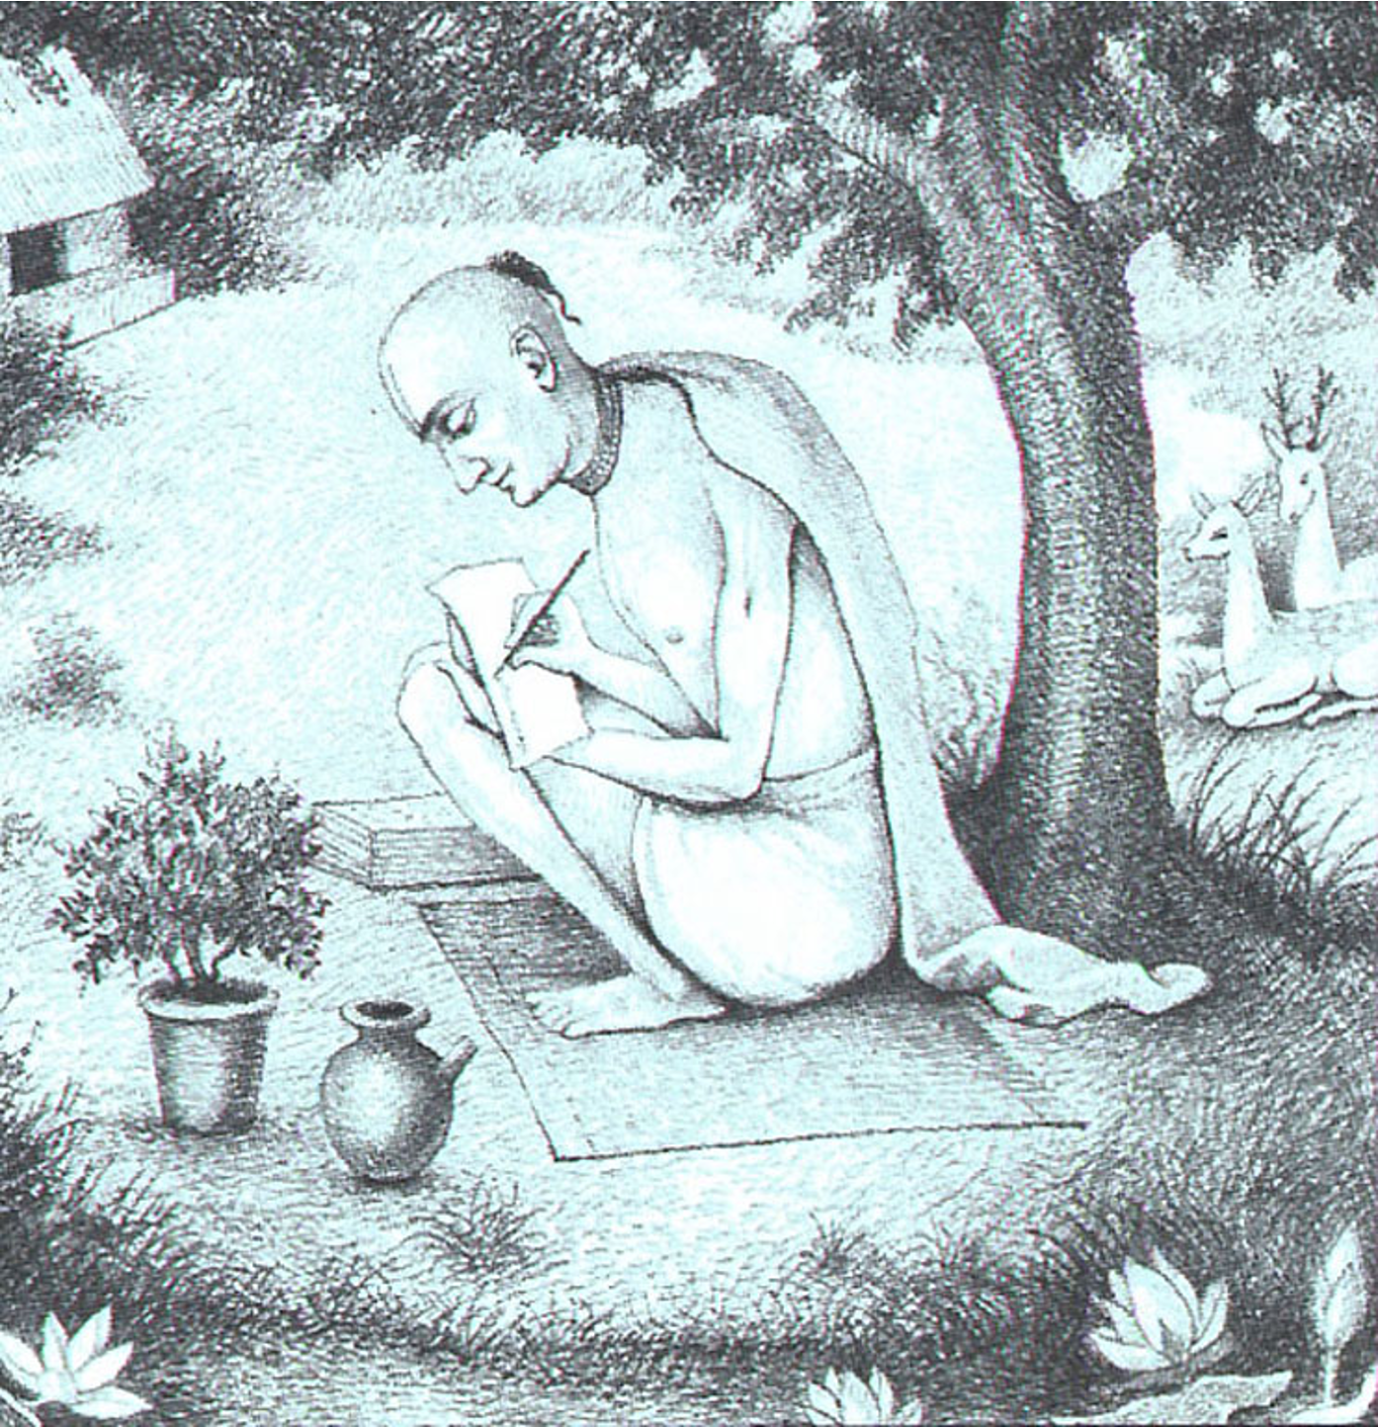
Kṛṣṇadāsa Kavirāja Gosvāmī says that he has been able to describe these
four pastimes of Śrī Caitanya Mahāprabhu
by the blessings of Śrīla Rūpa Gosvāmī.
Kṛṣṇadāsa Kavirāja Gosvāmī was not actually a direct disciple of Śrīla Rūpa Gosvāmī, but he followed the instructions given by Śrīla Rūpa Gosvāmī in
the Bhakti-rasāmṛta-sindhu. He therefore
acted according to the directions of Rūpa Gosvāmī and prayed in every chapter for his mercy.
CC Antya 19.101 / purport

Slide 37



Slide 38
Could Srila Prabhupada install a rtvic system?

Slide 39


Of course he could. But it is not a question of our willingness or unwillingness to accept that Srila Prabhupada, as the Founder-Acharya, could establish a new system of initiation. Rather it is a simple question of knowing and accepting what he actually said. And what he said is grand-disciple, disciple of my disciple, regular guru.

Slide 40
Although Srila Prabhupada wrote and spoke about his disciples becoming regular gurus, didn't he change his mind as he prepared to leave the planet, seeing that they were not qualified?

Slide 41
When Srila Prabhupada was asked whether he was dissatisfied with his disciples (as Srila Bhaktisiddhanta was) he said No. Rather, he said that he was satisfied.
When asked if he was leaving any work unfinished, he said, Yes, I have not established varnashrama-dharma.
This certainly would have been an appropriate time to state that he had not been able to create disciples qualified to be gurus upon his departure. But he did not.

Slide 42
If regular gurus is the system Srila Prabhupada wanted, why have we had so many problems with it?

Slide 43
We have had problems with gurukulas, sannyasis, marriages, etc. That we have a problem establishing the order of the guru does not mean the order or our understanding of it are wrong.

Slide 44
Wouldn't rtvik be a better system? Or couldn't we have both systems simultaneously; some initiates can opt for ISKCON gurus, some can opt for rtvik from Srila Prabhupada.

Slide 45
Our duty and salvation is in following the orders of our founder-acharya. Many thought the zonal acharya system sounded great, but in time it bore unexpected and bitter fruits. The great acharyas are trikalajna, they can perfectly see past, present, and future. Again, our duty and guarantee of success is in simply following the orders of the acharyas.

Slide 46
Aren't written orders more important than spoken orders (the May conversation being spoken; the July letter being written)?

Slide 47
Guru mukha padma vakya.... Narottama dasa Thakura enjoins us to be purified by the words emanating from the mouth of the spiritual master. Also, the May conversation was not just any conversation. It was an extremely formal and sober discussion. Srila Prabhupada had personally petitioned the GBC to meet together, decide if there were any important issues that needed further clarification before he departed, and then to come before him to discuss the issues.
The questions were in writing, and the answers were written down and entered into the GBC minutes books and signed by all the GBCs present.

Slide 48
Doesn't the July letter prove that Srila Prabhupada wanted a proxy system?

Slide 49
It proves that he wanted a proxy system for the remainder of the time he was physically on the planet, as everyone has agreed all along. It was intended as a time-bound system, put in place until Srila Prabhupada’s physical disappearance.

Slide 50
Srila Prabhupada's will mentions his initiated disciples. Doesn't that indicate that even in the future everyone will be Prabhupada’s disciple?

Slide 51
Again, history and context shed light on the situation. Review of the conversations surrounding this event shows that Srila Prabhupada’s concern was that the trustees / directors be “initiated devotees”, not merely top donors or friends of the movement.
However, one can ask: But why use the word my? Surely this means that all initiates in the future will be direct disciples of Srila Prabhupada.
But remember, at the time, everyone was a disciple of Srila Prabhupada. All the names listed as trustees / directors were Srila Prabhupada’s disciples.

Slide 52
Additionally, the future of a world without Srila Prabhupada being physically present had not yet become a reality for his followers.
Giriraja Maharaja, who was intimately involved in drafting the will, recalls: We weren’t used to thinking like that. In retrospect, it was very naïve. Interview / January 26, 1996

Slide 53
As presented earlier, ultimately, all future initiated devotees are Srila Prabhupada’s disciples in that they are following him and connected to him via the guru- parampara system.
In this sense, by the grace of Srila Prabhupada, one can become not only his disciple but at the same time the disciple of Srila Bhaktisiddhanta Sarasvati Thakura, Srila Bhaktivinode Thakura, the six Gosvamis, and all the other acharyas in Srila Prabhupada’s line.

Slide 54
The will states that the system of management should not change. Doesn't this mean no change from the proxy system established in the July letter?

Slide 55
The quote is taken out of context. In the will, system of management refers to the management structure of ISKCON. A change from proxy to regular gurus does not change the operational procedures for the management of ISKCON.
Rather, this transition from proxy to regular gurus is the traditional evolution that has taken place since time immemorial when the diksha guru is no longer physically present.
At that time, the responsibility to carry on the disciplic succession is naturally transferred to the shoulders of qualified disciples of the diksha guru.

Slide 56
Srila Prabhupada said When I order, you become guru.
When did he give the order?

Slide 57
Taken out of context, the sentence could seemingly point to a future order, but in fact Srila Prabhupada made this statement in the context of the May 28th conversation, as part of a detailed explanation.
Just previously in that conversation, Srila Prabhupada had said, So on my behalf, on my order... Amara ajnaya guru hana. Be actually guru, but by my order.

Slide 58
What about the Topanga tapes? Didn't Tamal Krsna Maharaja reveal that there was a conspiracy to cover up Srila Prabhupada's desire for a proxy system?

Slide 59
In the Topanga conversations, Tamal Krsna Maharaja says that it was a mistake to not expand the number of gurus sooner in ISKCON. He concedes that the zonal acharya system was wrong. He says that Srila Prabhupada wanted all his disciples to become qualified and become regular gurus.
Tamal Krsna Maharaja never said that Srila Prabhupada wanted a rtvik (proxy) system.

Slide 60

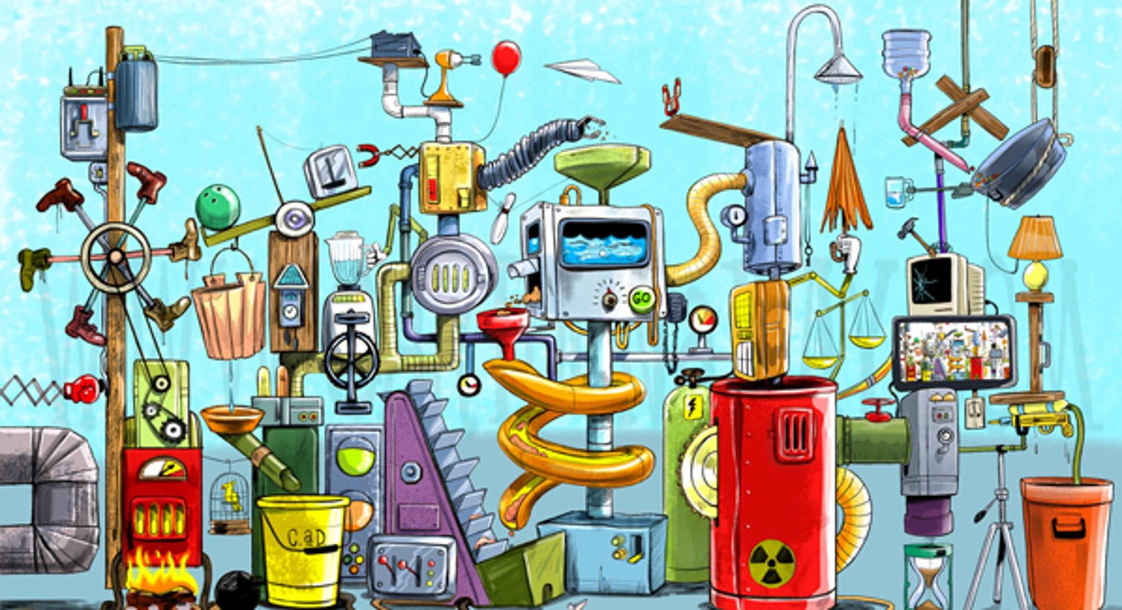
Conclusion
The rtvik advocates present a complex set of speculative arguments.

Slide 61

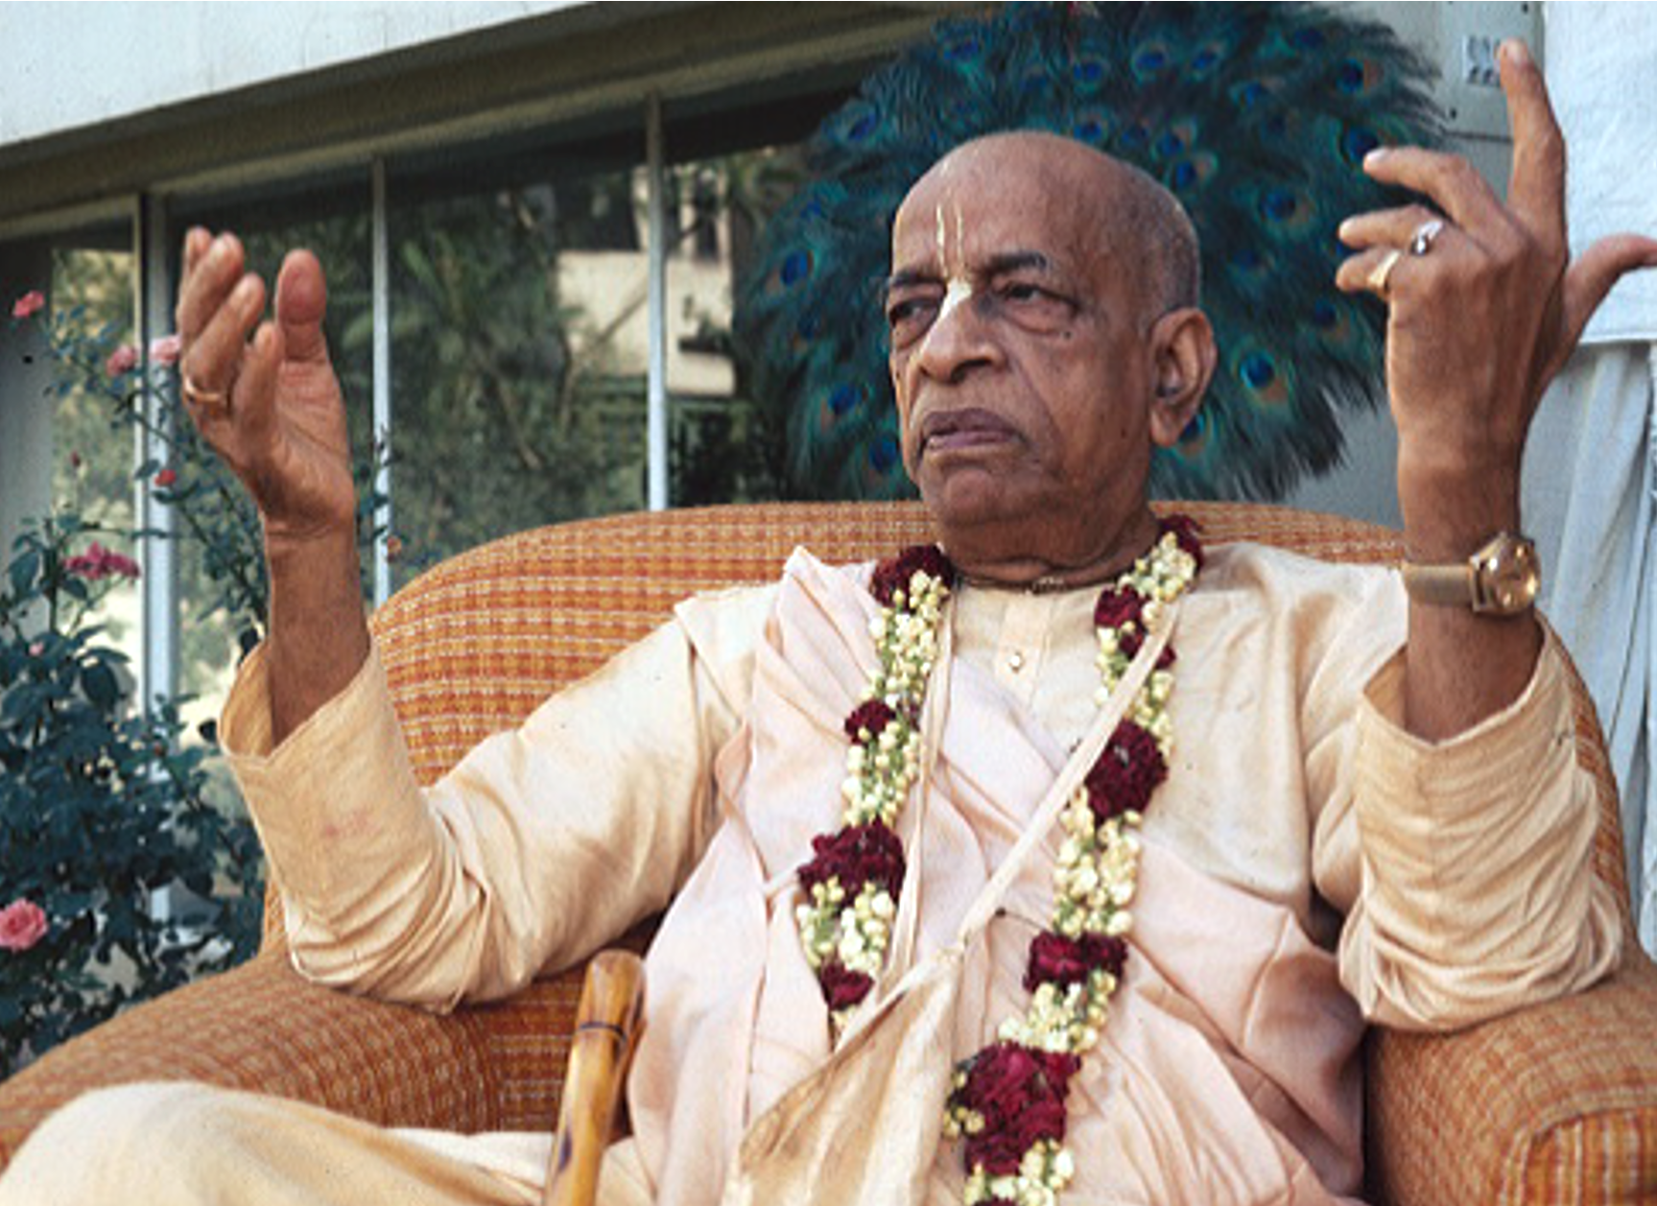
But they cannot provide one single piece evidence to answer the key question:
Where did Srila Prabhupada say that he will continue to accept disciples after
his physical departure?

Slide 62


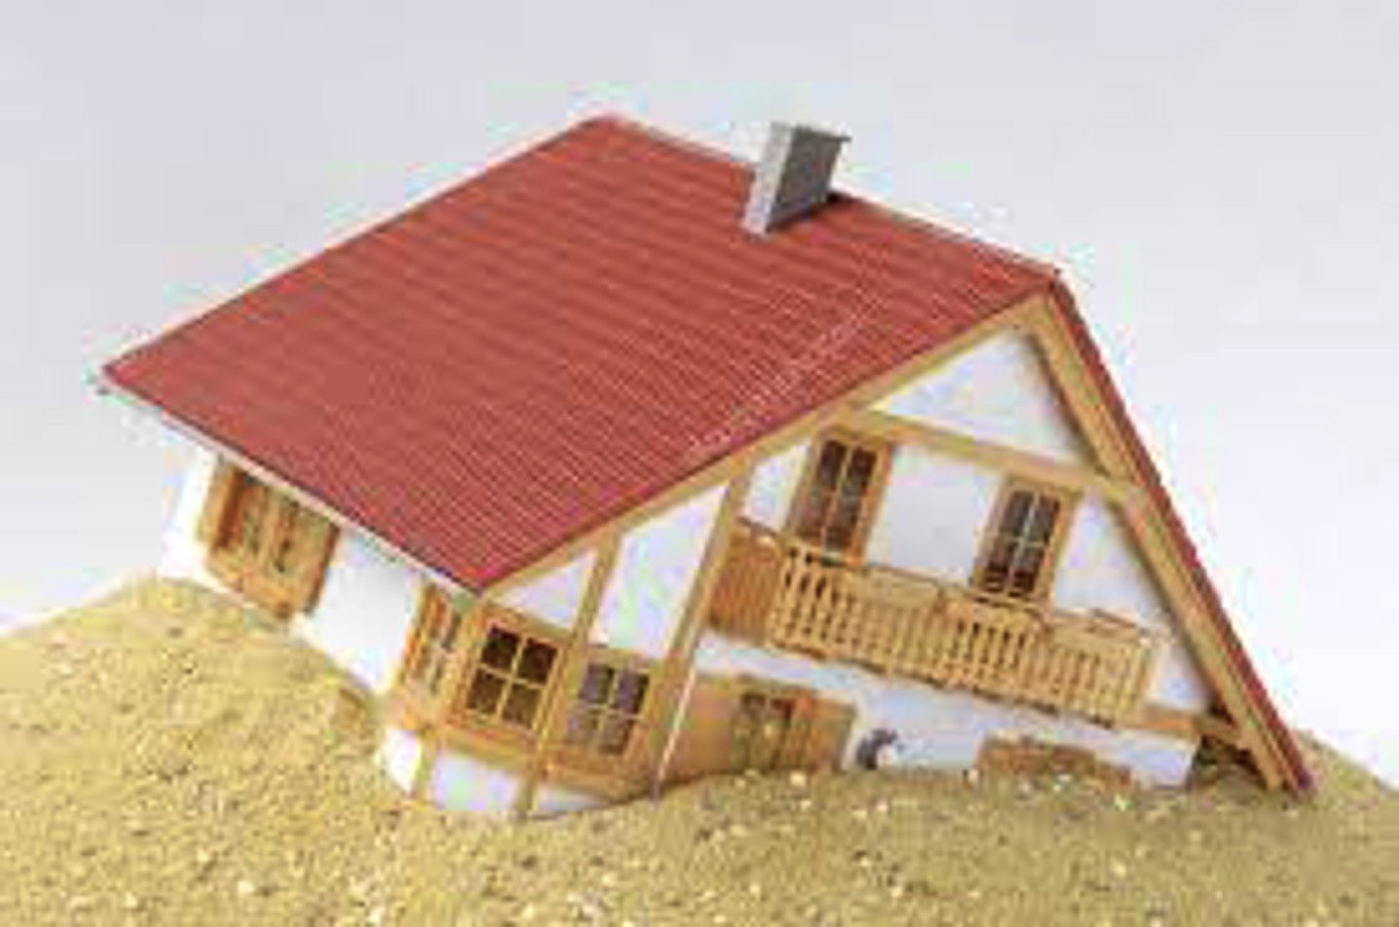
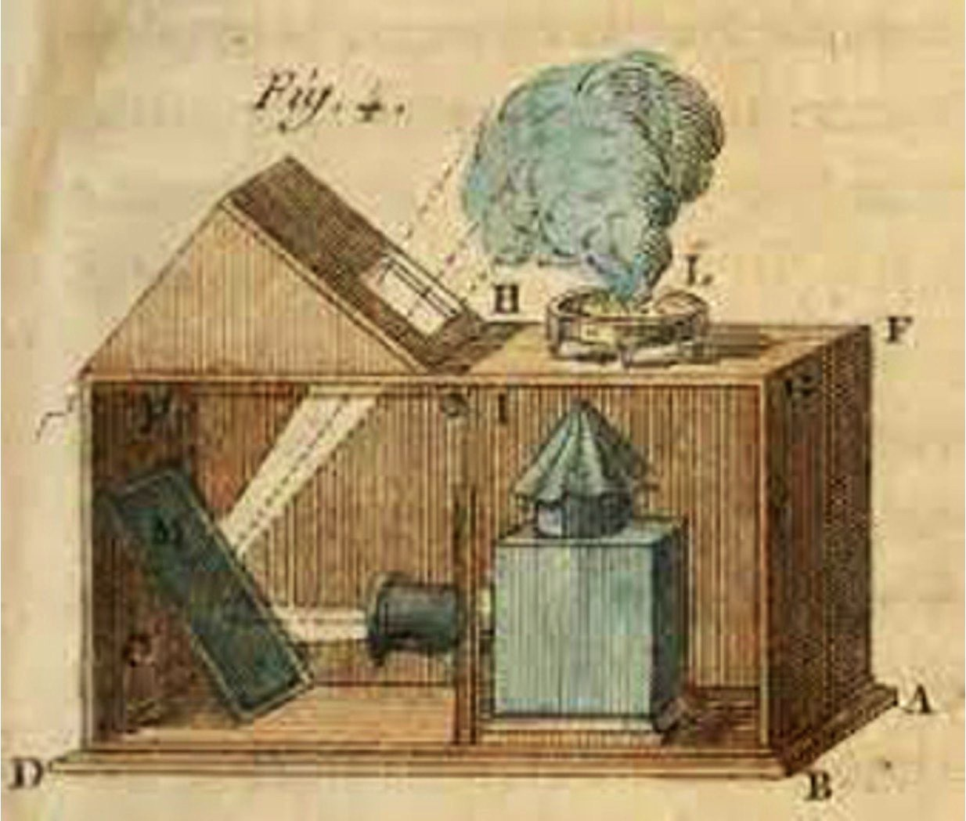
The fact is that their whole case is built on sand.
It is “smoke and mirrors”.
It is a bluff only.

Slide 63


The bottom line
Srila Prabhupada was formally asked by the GBC:
Our next question concerns initiations in the future, particularly at that time when you're no longer with us.
Srila Prabhupada answered:
Regular guru / Grand disciple Disciple of my disciple

Slide 64

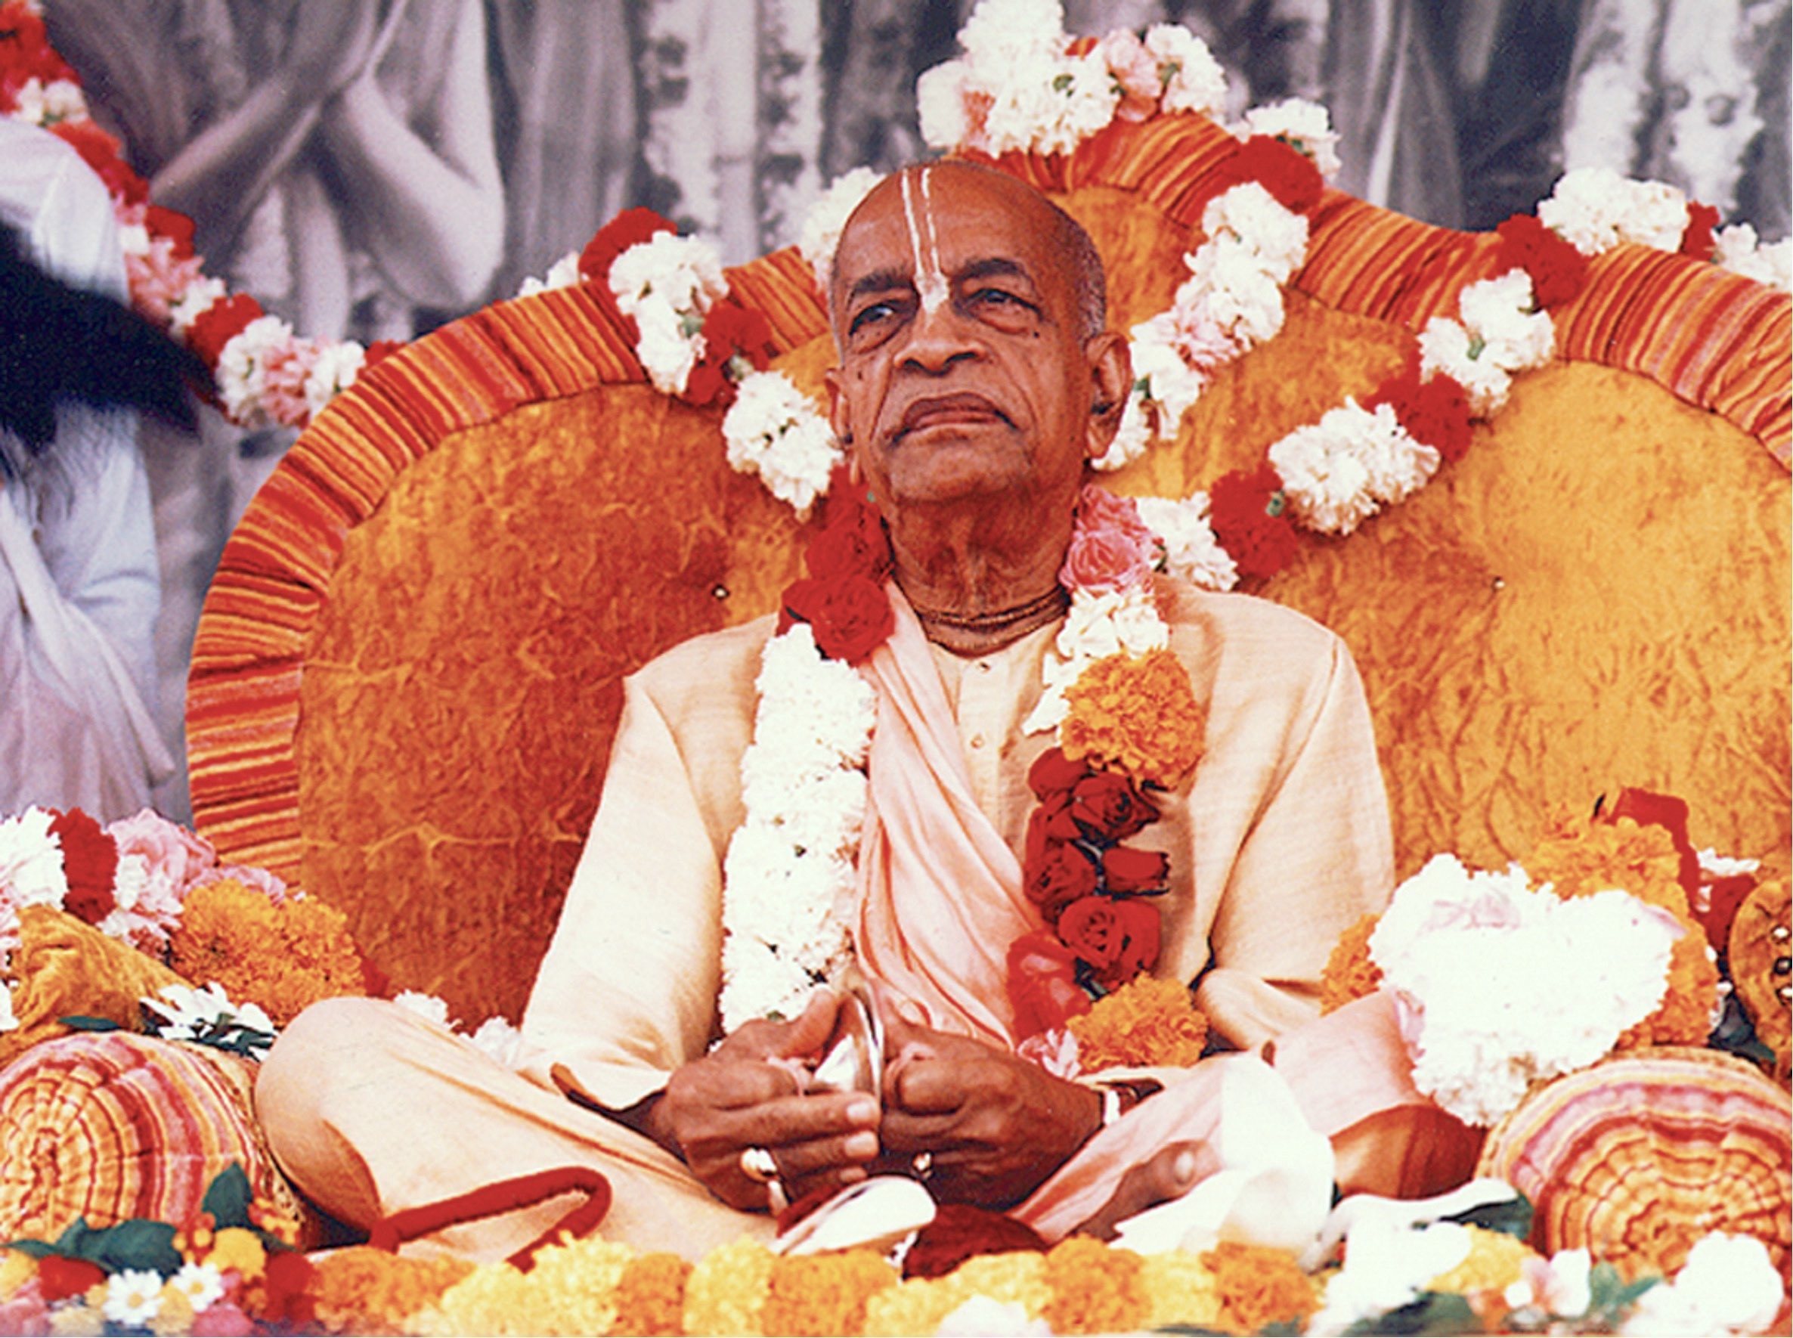
(the end)

Slide 65
References
“May 28th, 1977
Vrindaban” / Conversation: Srila Prabhupada and GBC
members (Folio)
“Disciple of my disciple” (GBC paper)
“Where the rtvik people are wrong” (Jayadvaita Swami)
“Rtvik Heresy” pamphlet (Drutakarma dasa and Badrinarayan Swami)
“100 refutations of Rtvikism” (Compilation by multiple ISKCON authors)

